Slide 1
State of the Climate 2024
Dr. John Perona
Corbett Issues Forum
1 February 2024
…this is the great project of our time,
and our obligation to future generations
www.fromknowledgetopower.com/earthward
johnperona.substack.com
johnjperona@gmail.com

Slide 2
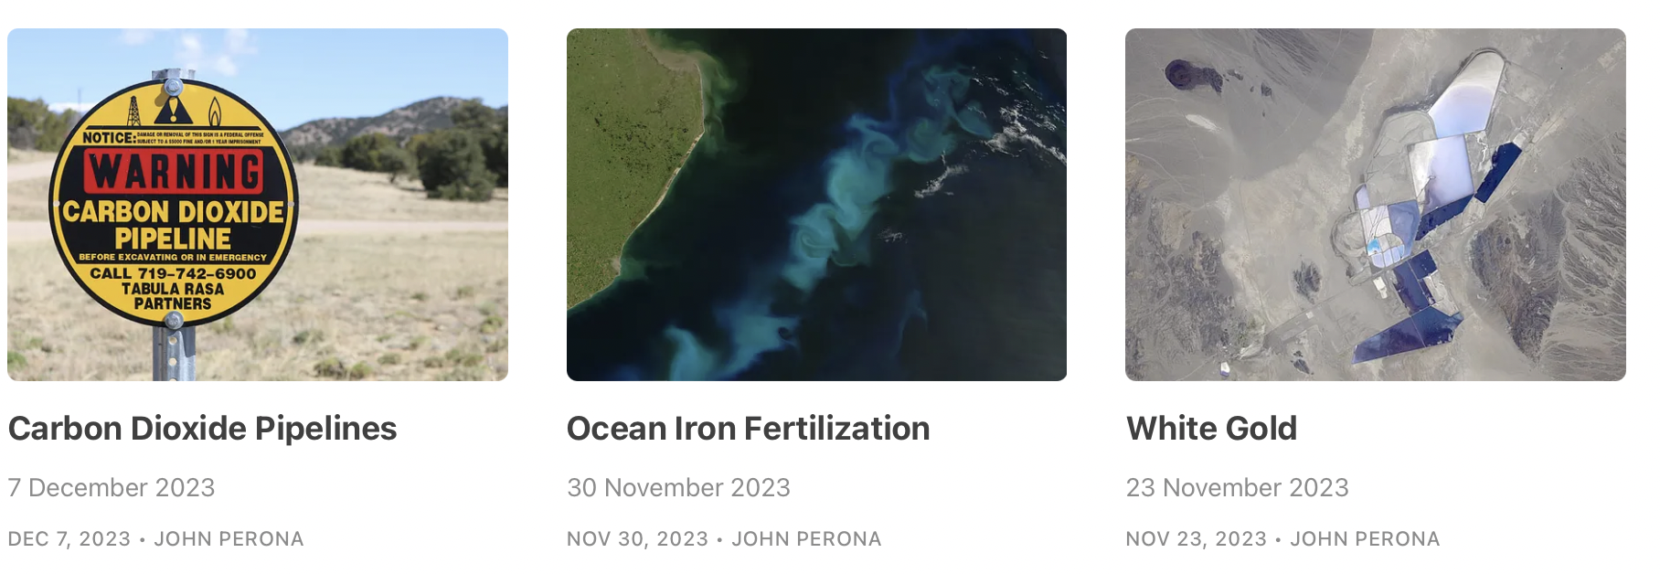
Earthward
climate and
renewable energy
newsletter,
launched June 2023
johnperona.substack.com
fromknowledgetopower.com/earthward

Slide 3
State of the Climate 2024
Global temperature records, 2023
Carbon dioxide emissions, global and US
Climate targets and pledges
United Nations process
-Global Stocktake; sector performance
-COP28, UAE, 30 Nov – 13 Dec 2023

Slide 4
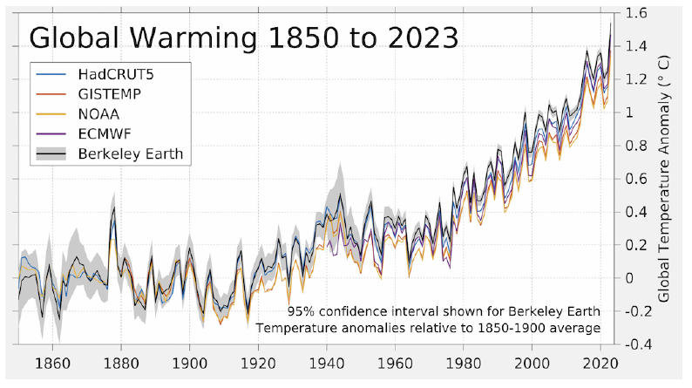
Berkeley Earth
2023 warming: 1.34$°$C – 1.54$°$C (range among the five data sets)

Slide 5
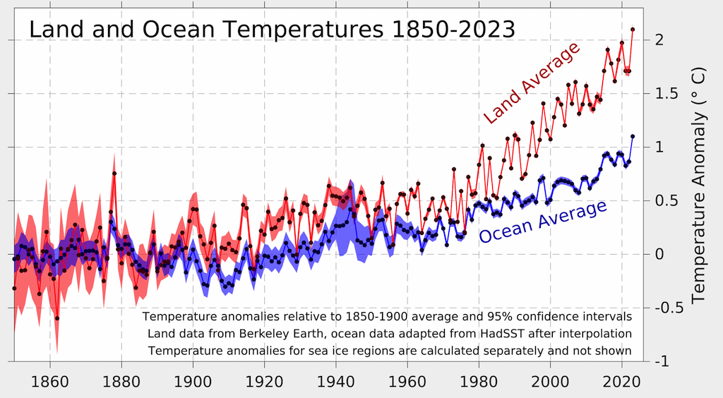
Berkeley Earth

Slide 6
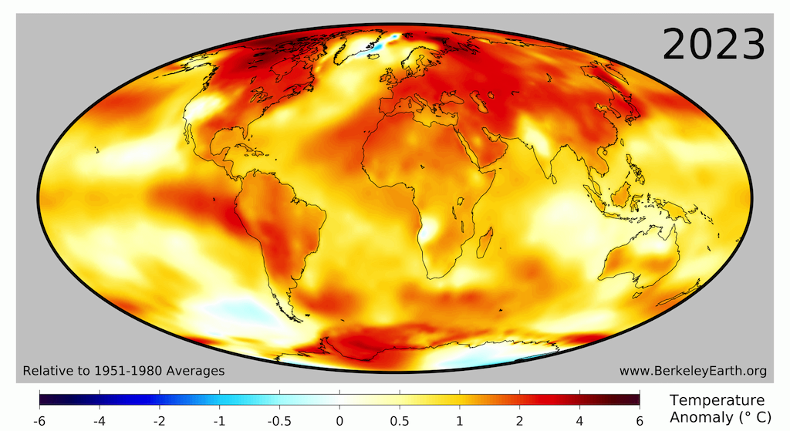
Global temperature anomalies
Land surface is warming much more than ocean surface
Arctic is warming more because of the ice albedo + feedback
Area experiencing cooling continues to shrink

Slide 7
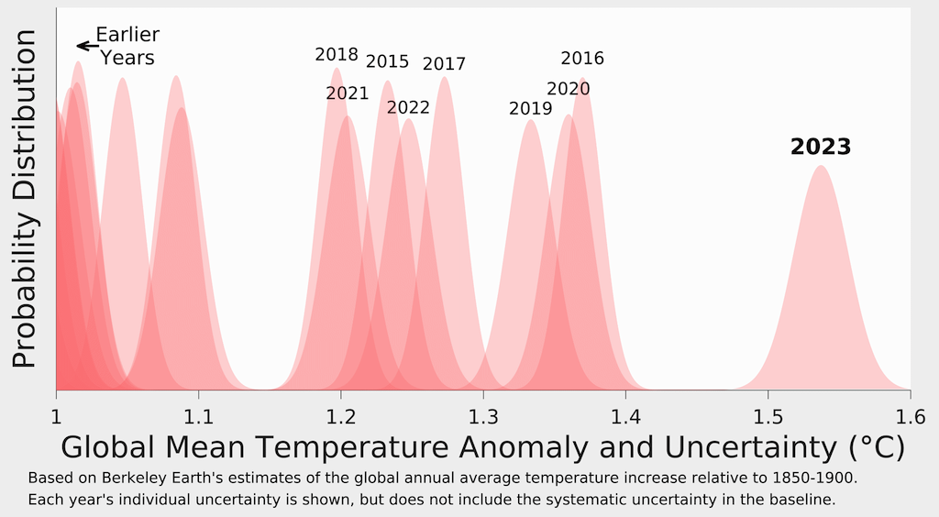
2023 was an extreme outlier. Why?
Baseline:
1850-1900
Start of El Nino: natural climate variability
Pollution control: reduction of cooling atmospheric aerosols

Slide 8
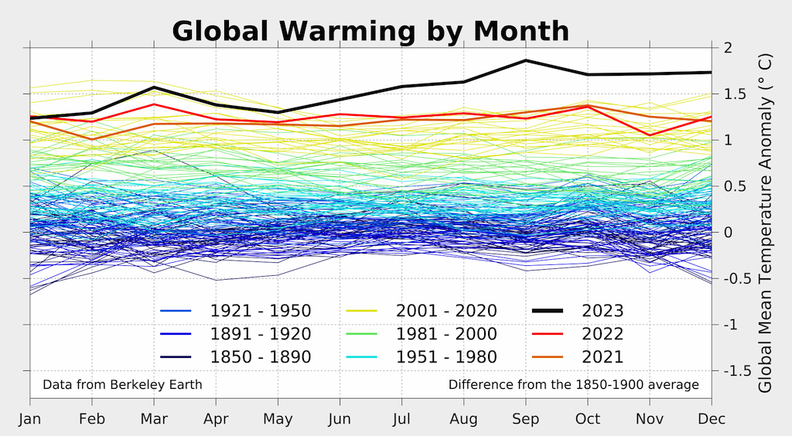
Excessive warming occurred in Summer and Fall
Through May, 2023 did not appear to be record-setting
New climate science term coined: gobsmackingly bananas

Slide 9
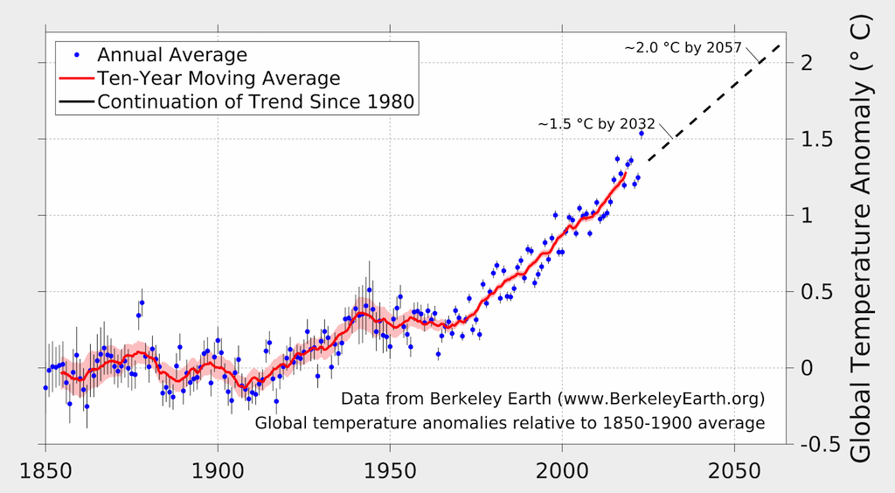
1.5$°$C of warming is now expected in 2032
Current warming ~1.25$°$C ➔
The 1.5$°$C metric defined as a running average over many years
One year above 1.5$°$C doesn’t mean this target is exceeded
Reality check: 1.5$°$C is now effectively out of reach

Slide 10
Large predicted increase in impacts from 1.5$°$C to 2.0$°$C
Coral reefs heat wave uneven: $$$ large, abrupt
Arctic heavy rain soc justice physical irreversible
Biodiversity drought. exposure degrad. ice sheets melt
hotspots wildfire. vulnerability ecosystem
floods loss
Credit: IPCC 1.5

Slide 12
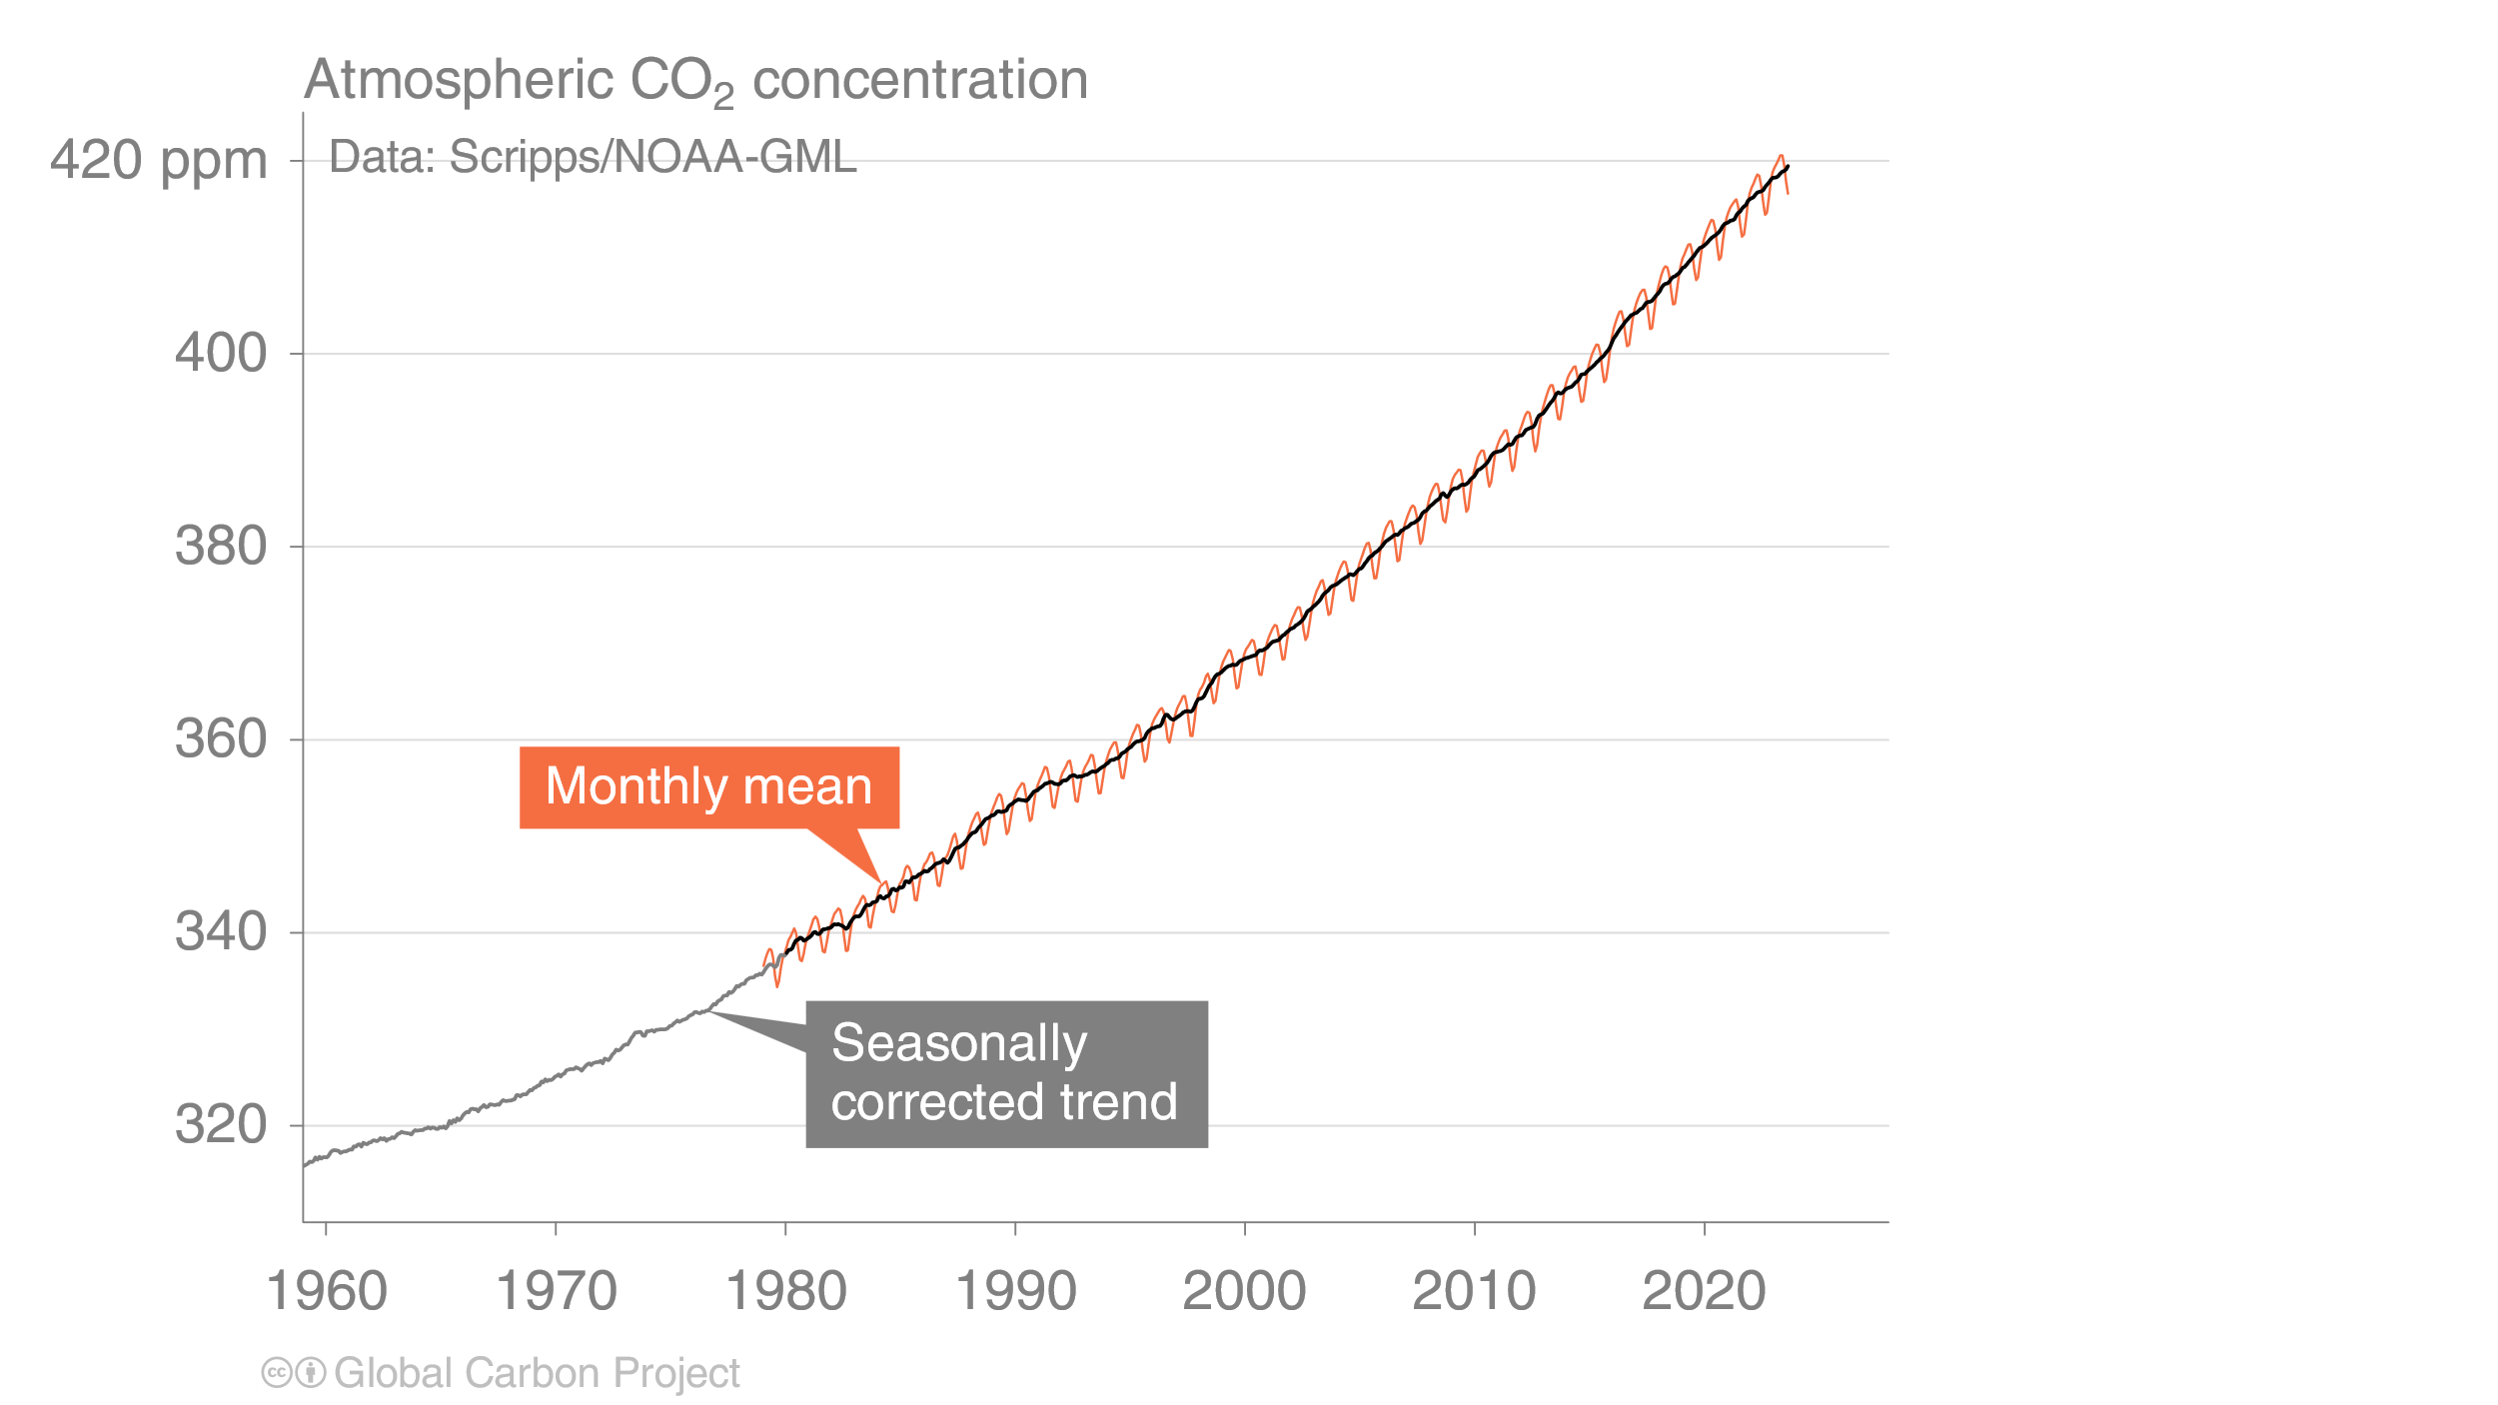
Atmospheric CO₂ concentration
1750: ~277 ppm
2023: 419.3 ppm
(yearly avg)
Atmospheric CO₂ buildup continues at the same pace
Data from Global Carbon Project, published Dec. 2023

Slide 13
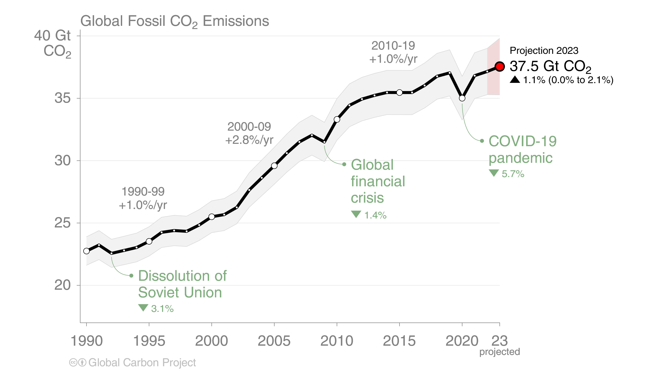
Global Fossil CO₂ Emissions
Global fossil CO₂ emissions: 37.1 ± 2 GtCO₂ in 2022, 1% higher than 2021 Projection for 2023: 37.5 ± 2 GtCO₂
The 2023 projection is based on preliminary data and modelling. Source: Global Carbon Project 2023

Slide 14
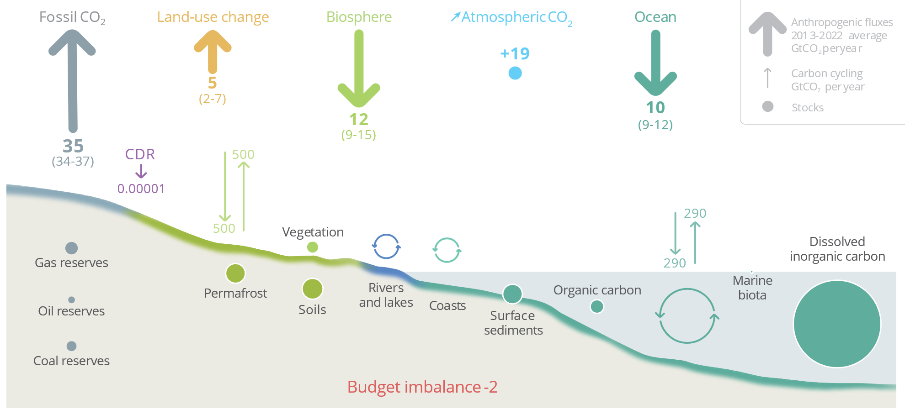
Global carbon cycle, Gt CO₂/yr avg, 2013-2022
Global Carbon Project
This slide contains information on:
(i) Where Earth’s carbon is (ii) How it moves around
(iii) What happens to anthropogenic input (iv) Progress on CDR

Slide 15
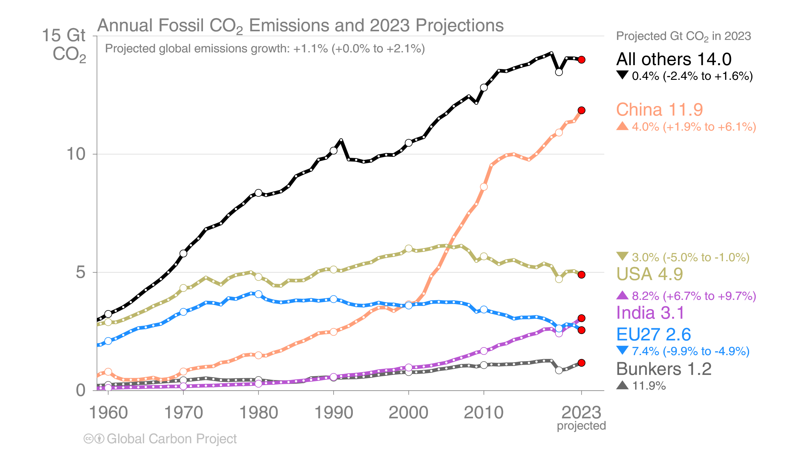
Regional emissions vary substantially
Global Carbon Project 2023
Yearly emissions falling: European Union, United States, “All others”
Yearly emissions increasing: India, China, “Bunkers”

Slide 16
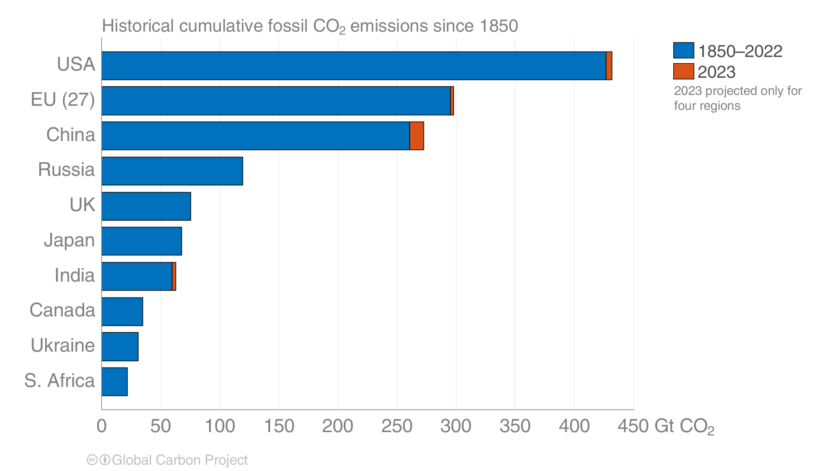
Historical responsibility for GHG emissions
China is no longer a “developing country”
US is by far the worst in emissions per capita

Slide 17
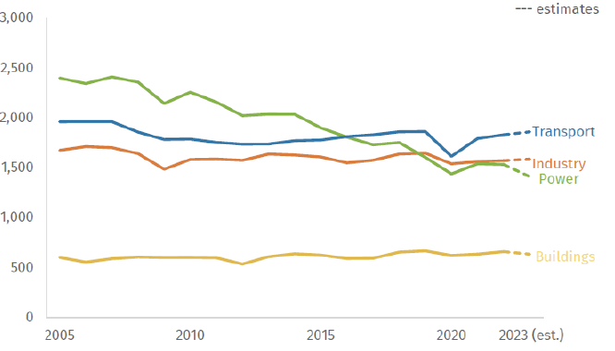
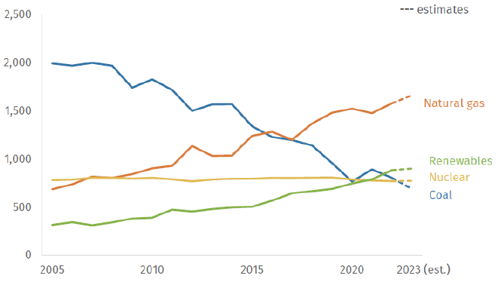
US greenhouse gas emissions, 2023
Overall decrease: 1.9%
in CO₂-equivalent emissions
GDP expanded 2.4% in 2023
8% GHG emissions decrease
in electric power sector
4% GHG emissions decrease
from residential/commercial
buildings
GHG emissions increases:
1.6% (industry), 1% (transport)
ELECTRICITY
Rhodium group, 10 Jan 2024

Slide 18
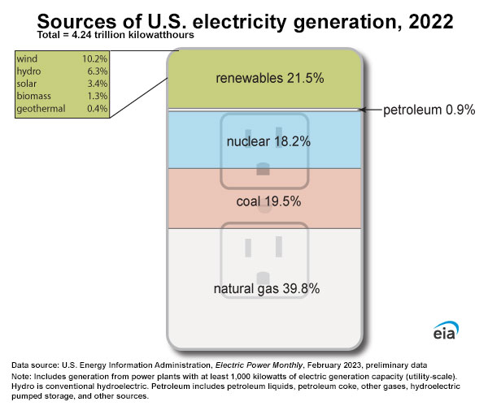
2023: coal
decreased

Slide 19
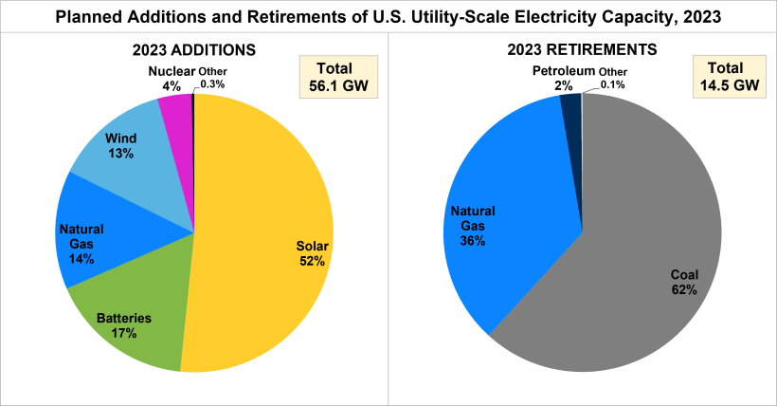
Newly added and retired electric power in 2023
Credit: DOE
Total US capacity ~ 1300 GW

Slide 21
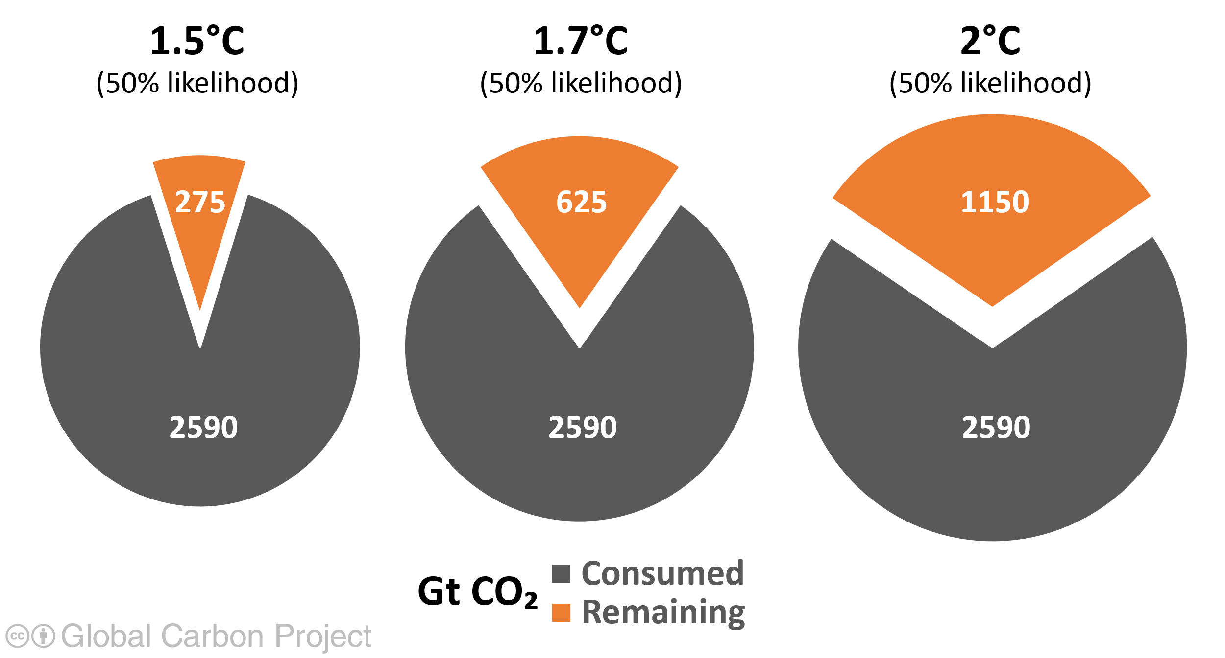
Remaining carbon budgets: Jan 1, 2024
To limit warming to 1.5°C , 1.7°C and 2°C, we can emit 275 GtCO₂, 625 GtCO₂, and 1150 GtCO₂ respectively (7, 15 and 28 years from 2024) 2590 GtCO₂ have been emitted since 1750
Quantities are subject to [additional] uncertainties e.g., future mitigation choices of non-CO₂ emissions
Source: IPCC AR6 WG1; Friedlingstein et al 2023; Global Carbon Budget 2023

Slide 22
A 2.0$°$C world is attainable
To maintain temp.
rise under 2.0$°$C :
Decrease CO₂
emissions to
25-33 Gt/year
by 2030
[2023 = 37 Gt]
Decrease CO₂
emissions to
zero by 2075
Reductions in GHG
emissions can be
much more gradual
compared to 1.5$°$C
$$°$$
Credit: United Nations Environment Programme (UNEP)

Slide 23
US pledge for net zero: COP26, Glasgow, 2021
2023 US emissions: about 18% below 2005 levels
2025 projected target: seems unlikely to be met
2030 target depends on IRA implementation + more

Slide 24
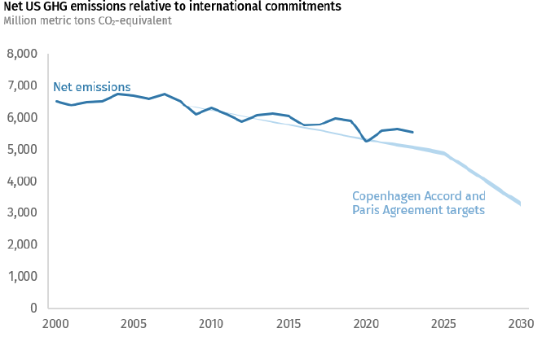
Is the US on track for its Glasgow pledge?
Rhodium group
2023: 17-18% below 2025 level Reality
2025: 26-28% below 2005 level Pledge
2030: 50-52% below 2005 level Pledge
2023 emissions reduction: 1.9%. Needed through 2030: 6.9%/year

Slide 25
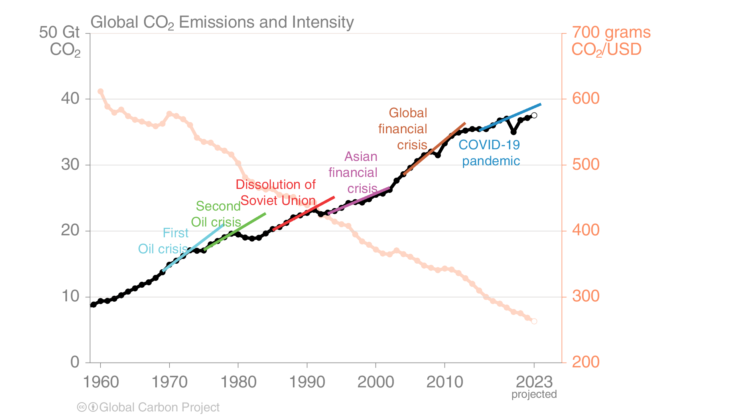
Steady decrease in carbon intensity
Decreases in carbon intensity don’t yet offset energy growth
Emissions go down in response to economic or social crises

Slide 27
Global Stocktake
Paris Agreement, Article 14, 2015
COP21:
“assess the collective progress
toward achieving the purpose of
the Agreement and its long-
term goals…”
COP24, 2018: Agreement that the Global Stocktake
will address climate progress in:
Mitigation (stay below 2$°$C; ideally 1.5$°$C);
Adaptation (enhance resilience; reduce vulnerability)
Means of implementation (finance, technology transfer,
capacity building)
Loss and Damage (compensation for losses; equity)

Slide 28
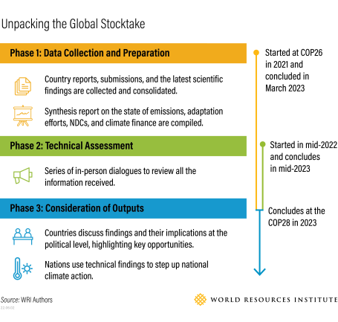
Global Stocktake Process
Key Products:
Global Stocktake
Synthesis Report
(September 2023)
[end Phase 2]
Political resolution:
-Document agreed
to by all parties
(199 countries)
[end Phase 3;
COP28; UAE]

Slide 29
In support of the Global Stocktake
State of Climate Action 2023:
Translates Paris Agreement’s 1.5$°$C temperature limit into
targets applicable to 42 distinct economic sectors
Frank assessment of progress
Goes beyond a Report Card (the Stocktake) to offer a roadmap
and basis for concrete commitments by leaders
(next round of NDCs is in 2025)
https://systemschangelab.org/sites/default/files/2023-11/SoCA_2023_rev7.pdf

Slide 30
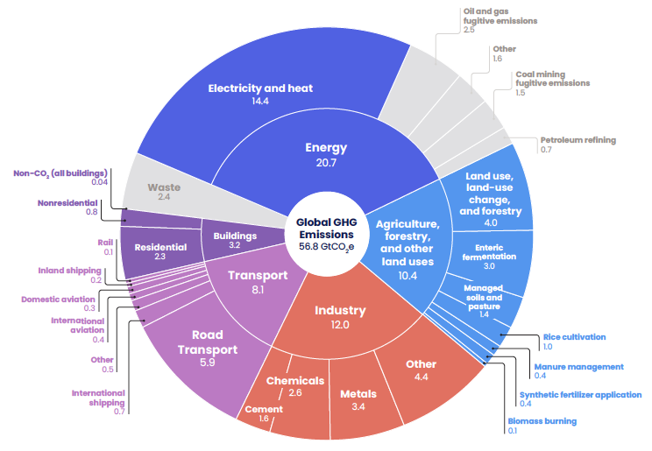
2021 global emissions by sector
https://systemschangelab.org/sites/default/files/2023-11/SoCA_2023_rev7.pdf
Helps prioritize investment in decarbonization

Slide 31
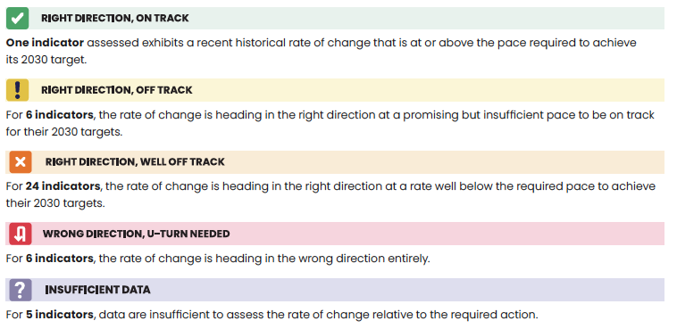
Assessment of global progress toward 2030 targets (1.5$°$C)
42 sectors: 1 + 6 + 24 + 6 + 5
Covers 85% of global CO₂(e) emissions

Slide 32
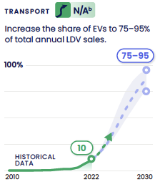
ON TARGET for 1.5$°$C: New sales of electric cars
S-shaped curve – characteristic of
successful new technology
adoption
N/A – no linear estimate of how much
faster the sector has to develop
LDV – light duty vehicle

Slide 33
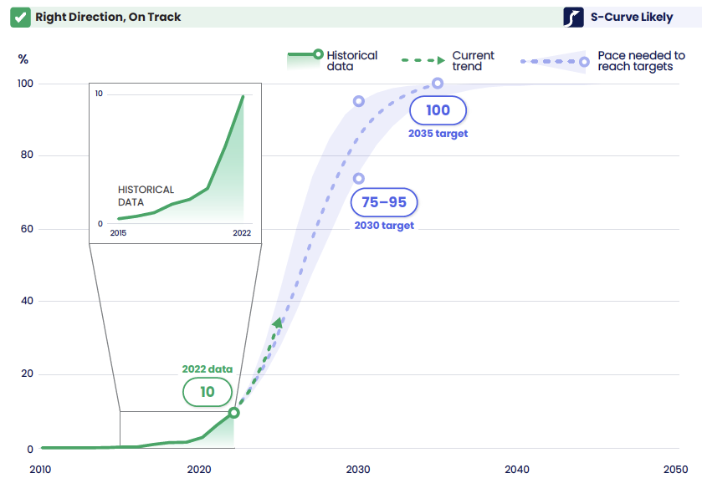
ON TARGET for 1.5$°$C: New sales of electric cars
S = sigmoidal
BEV’s only – no hybrids, plug-in or otherwise
S-curve fit to historical data: author judgment; multiple lines evidence

Slide 34
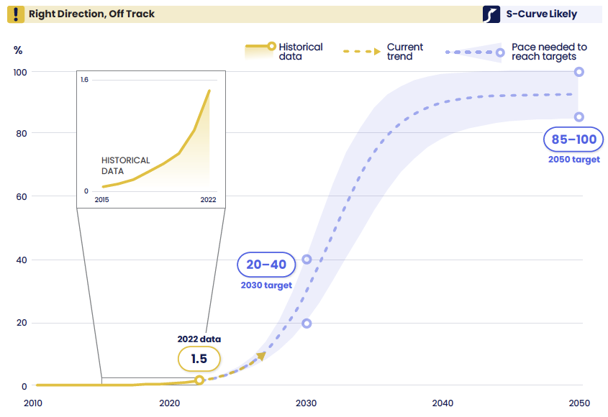
Share of EVs in the light duty fleet
Still in the “emergence phase” of the S-curve (only 1.5%)
Uncertainties about how fast ICE vehicles will be retired

Slide 35
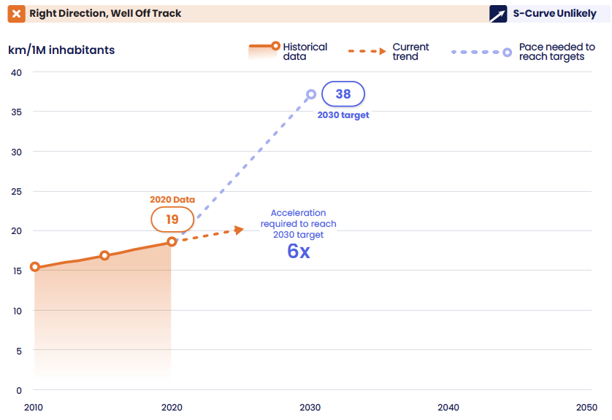
# kilom. rapid transit infrastructure / 1 million inhabitants (top 50 most populous cities)
S-curve unlikely; 6x linear acceleration needed for 1.5$°$C target (2030)

Slide 36
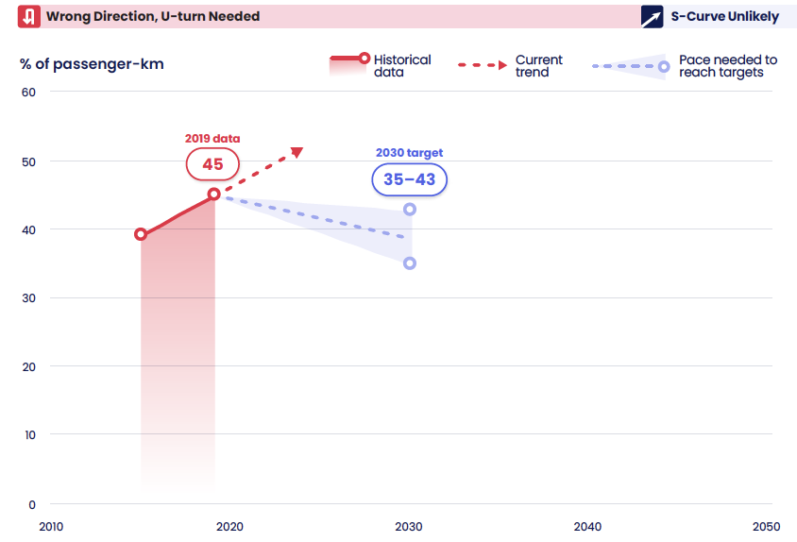
Share of kilometers traveled by passenger cars
No S-curve; and no linear scale factor for acceleration
U-turn Needed!

Slide 37
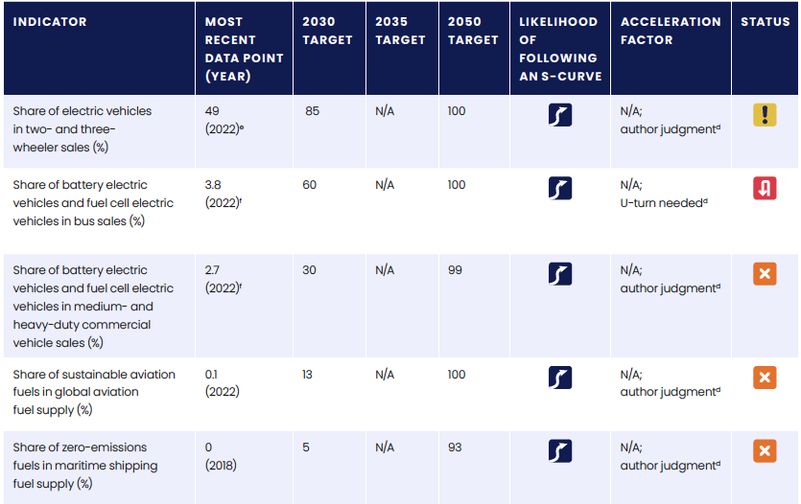
Global progress toward transportation targets
All transportation: 10 indicators: 1/2/5/2

Slide 38
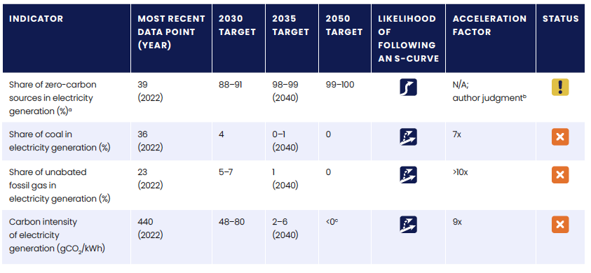
Global progress on electric power targets for 1.5$°$C world

Slide 39
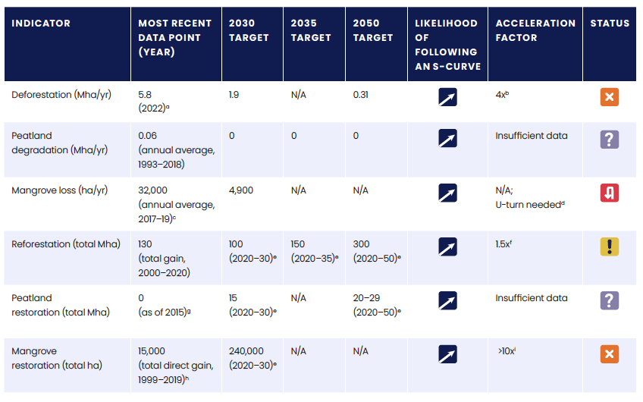
Global progress toward forests and land targets

Slide 40
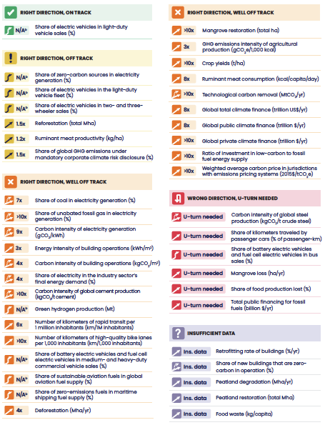
Summary of all
42 indicators

Slide 42
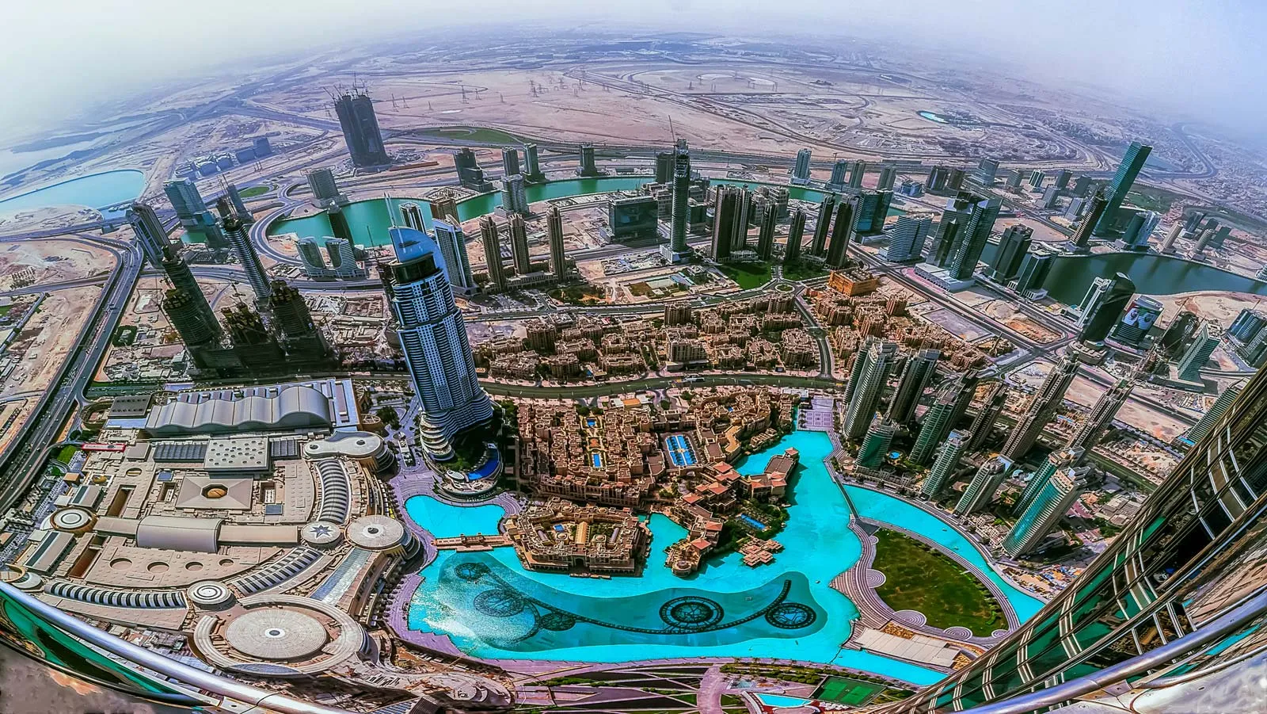
Third leading OPEC oil producer
Authoritarian regime
Women’s rights restricted
(despite publicity photo)
Protestor voices limited
Sultan Ahmed Al-Jaber presided
over COP28 AND is the
head of the Abu Dhabi
National Oil Company

Slide 43
Language and Controversy
Opposition to (perceived) fossil fuel agenda
by healthy climate advocates around the world
Sultan Al-Jaber quote (gaffe?) – there is “no science” showing
that phasing out fossil fuels is necessary to solve climate change
John Kerry (US climate envoy) – “maybe it came out the wrong way”
Al-Jaber’s (and fossil fuel companies’) apparent position –
Fossil fuels are fine as long as they are not “unabated”

Slide 44
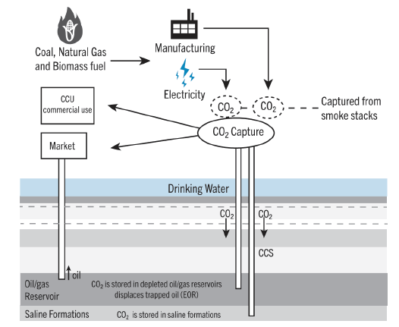
Carbon capture & storage (CCS)
CCS in industry:
mitigation
Smokestack gas
contains about
5-15% CO₂
[Atmosphere:
0.04% CO₂]
Credit:K2P
Captured CO₂ from power plants and manufacturing industries
can be permanently and safely sequestered in geologic reservoirs
CCS is “best system of emissions reduction” for CO₂ mitigation
under new Clean Air Act regulations (2024)
CCS awarded generous federal tax credits under the IRA (2022)
Notes:
Here is something else that falls in the category of mitigation. Cement, steelmaking, petrochemicals, fertilizers, glass making, hydrogen production, etc – all fit here. Possible today because of very high CO2 level in smokestack gases.

Slide 45
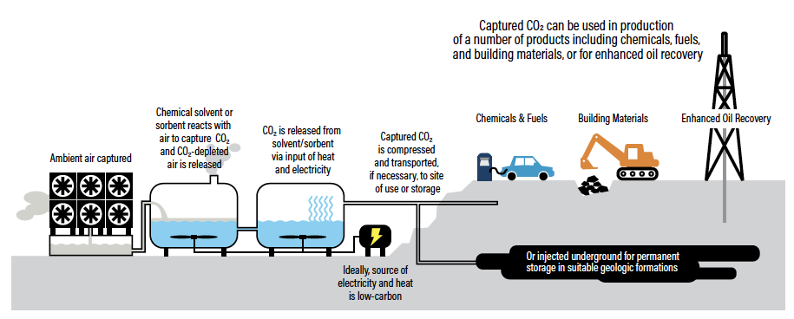
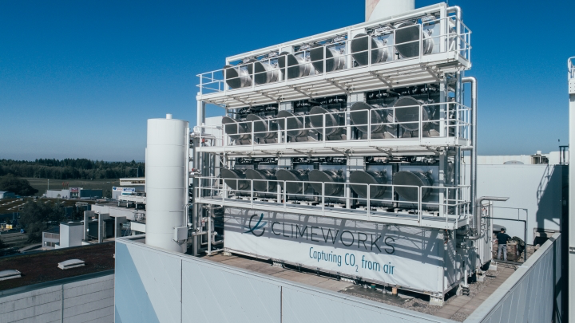
Direct Air Capture and Storage (DACS):
Credit: WRI, Carbon Shot (2020)
Overlapping technology with industry CCS
Near unlimited potential
Gets at the root of the climate problem
Credit: ClimeWorks
Notes:
This isn’t adaptation or mitigation either. This is solving the problem via industrial engineering. Very very tough, huge energy input needed to concentrate the carbon dioxide. Doing the same thing as planting 3 trillion trees. And if DAC doesn’t work, maybe enhanced weathering or an ocean-based approach.

Slide 46
Key agreements
Al-Jaber’s (and fossil fuel companies’) position – Fossil fuels
are fine as long as they are not “unabated”
But: methane leaks, mobile sources, pollution and social costs, etc
Agreement calls for all countries to contribute to 8 global efforts:
-“Transition away” from fossil fuels in energy systems, in a just, orderly
and equitable manner, accelerating action in this critical decade, so as
to achieve net zero by 2050 in keeping with the science…
-Accelerate and substantially reduce non-CO₂ emissions globally…
-Accelerate efforts toward phase-down of unabated coal power…
-Triple renewable energy and double energy efficiency by 2030…

Slide 47
Weak points in the agreement
“Transitioning away from fossil fuels” is perceived to be weaker than calling for a fossil fuel “phase-out”
Agreement calls for accelerating “low-emission technologies.”
This includes “low carbon” hydrogen (ie, blue hydrogen; CCS)
Agreement recognizes that “transitional fuels” are important in
“energy security.” Interpreted as sanctioning natural gas.
No specific baseline for tripling renewable energy by 2030
Climate finance lags, $100B/yr target unmet; but needs of developing countries are much greater.
“Loss and damage” fund [equity] finally sanctioned, but very low funding

Slide 48
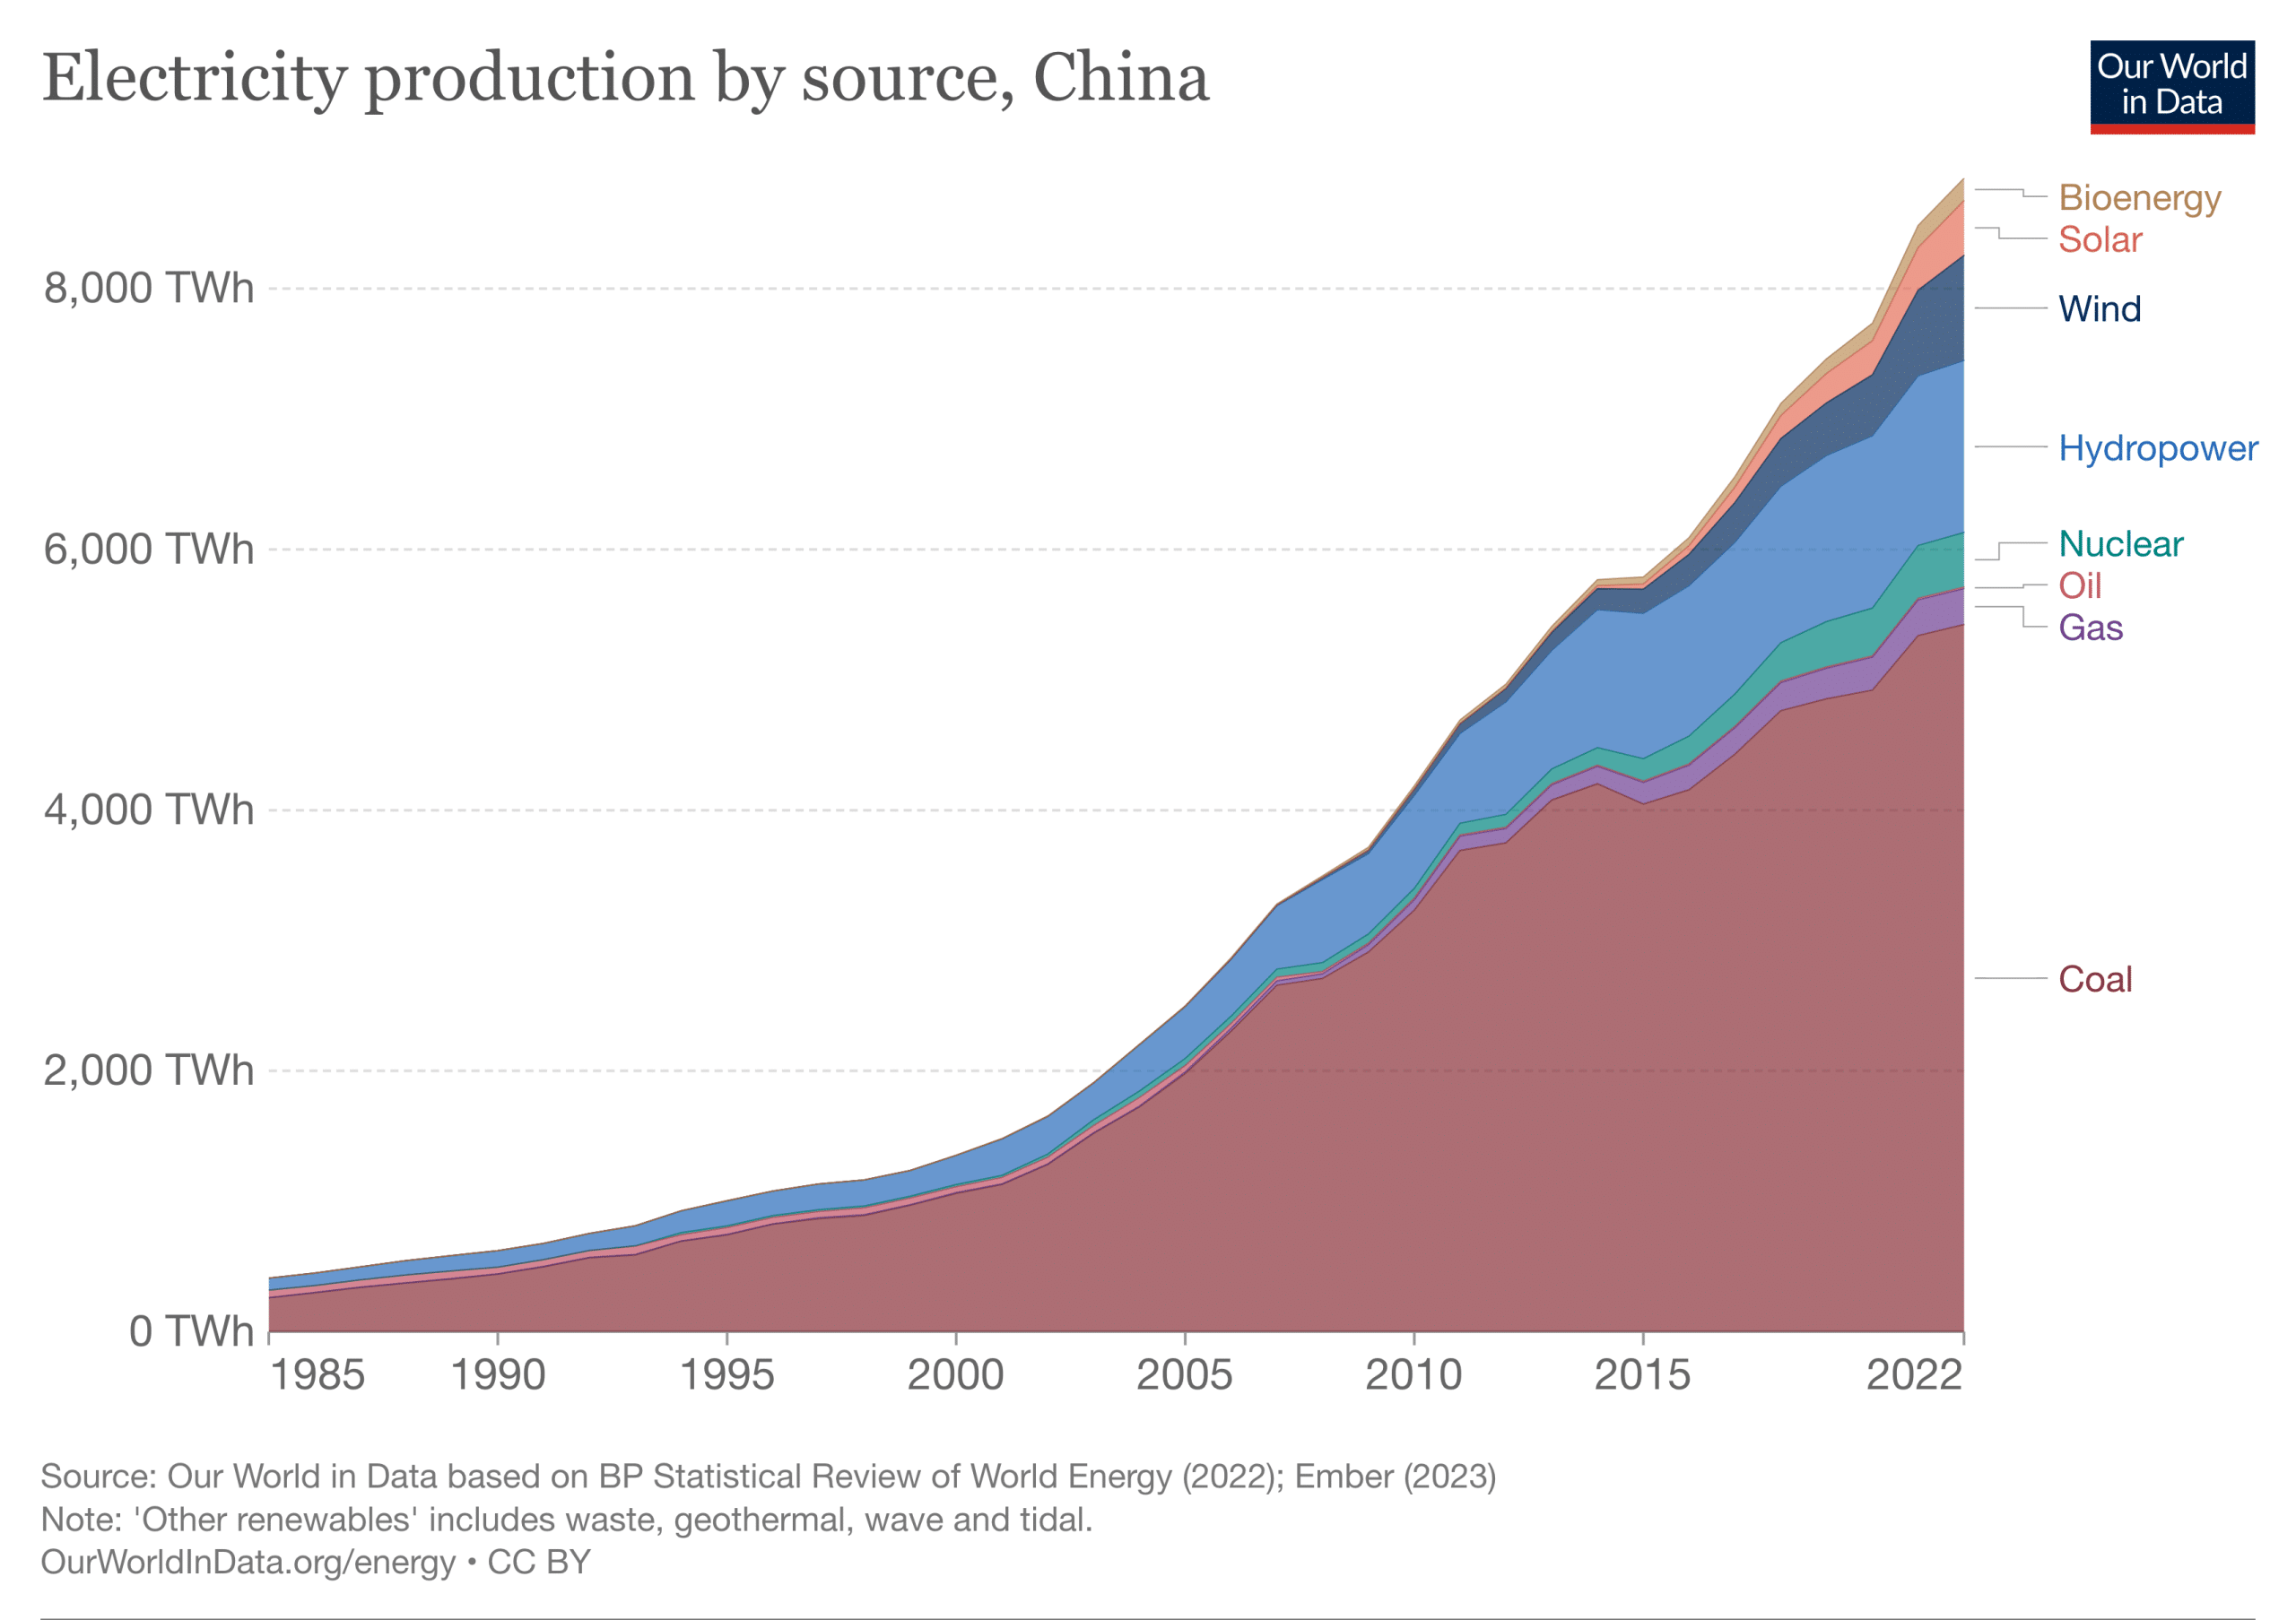
US-China collaboration
Sunnylands statement on cooperation: joint statements on a
wide range of climate issues
Summit on methane and other non-CO₂ greenhouse gases
cohosted by China and US ➔ results in a key pledge
made by all 199 countries
China’s huge recent growth
in solar and wind power
Credit:
Our World in Data

Slide 49
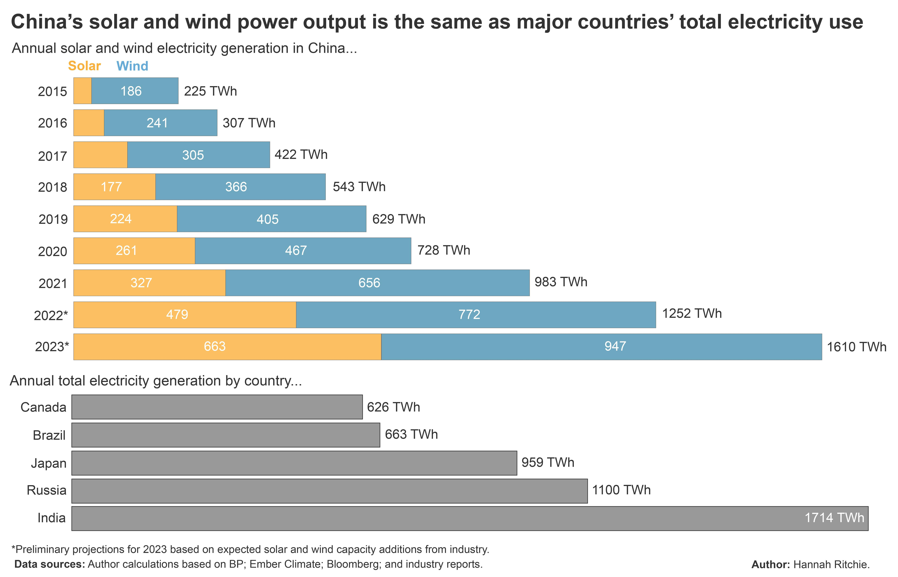
China’s growth in solar/wind power
Credit:
Our World in Data
In 2023, China added 2x as much solar generation as the US has
China’s GHG emissions are expected to begin decreasing next year,
6 years ahead of projections from a few years ago
China’s population has begun to decline and will continue to do so

Slide 50
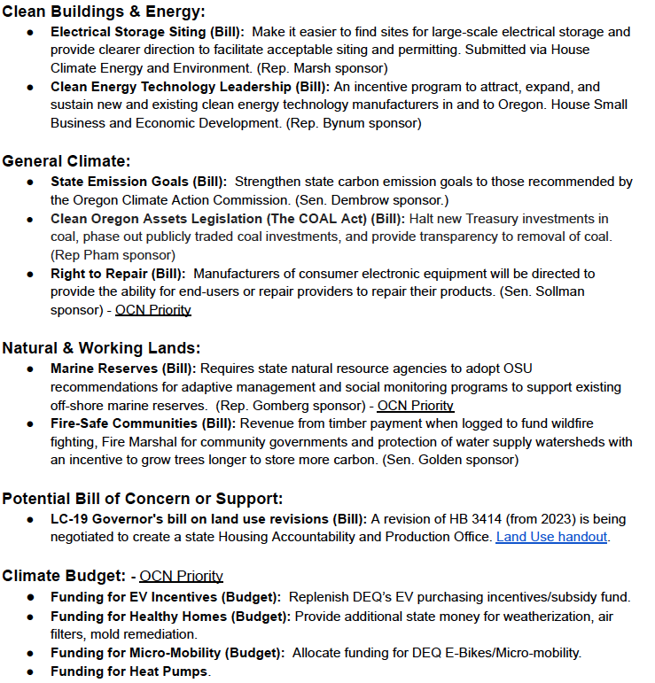
Oregon 2024
short legislative
session
Legislative
support
opportunities
(MCAT* team)
*Mobilizing
Climate
Action
Together!

Slide 51
Thank you!
John Perona; johnjperona@gmail.com
www.fromknowledgetopower.com
https://www.linkedin.com/in/john-perona-b31542124/

