Slide 1
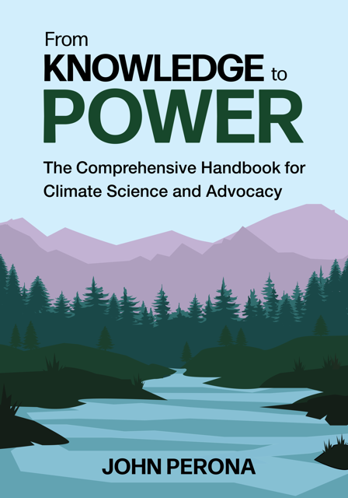
Geoengineering: The Big Picture
Dr. John Perona
Department of Chemistry
Portland State University
Electrify Now
15 March 2023
www.fromknowledgetopower.com

Slide 2
Geoengineering: The Big Picture
Earth’s energy balance: a wee primer
What is geoengineering?
Key distinctions among climate technologies
(Re)-modifying the atmosphere
Geoengineering hazards and governance
Notes:
Here is our agenda for today and I warn you this is not your typical climate presentation but rather a different paradigm with a unique set of hazards that requires new thinking, and you are not going to be able to ignore this

Slide 3
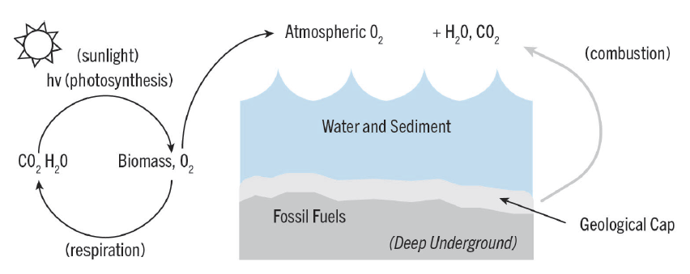
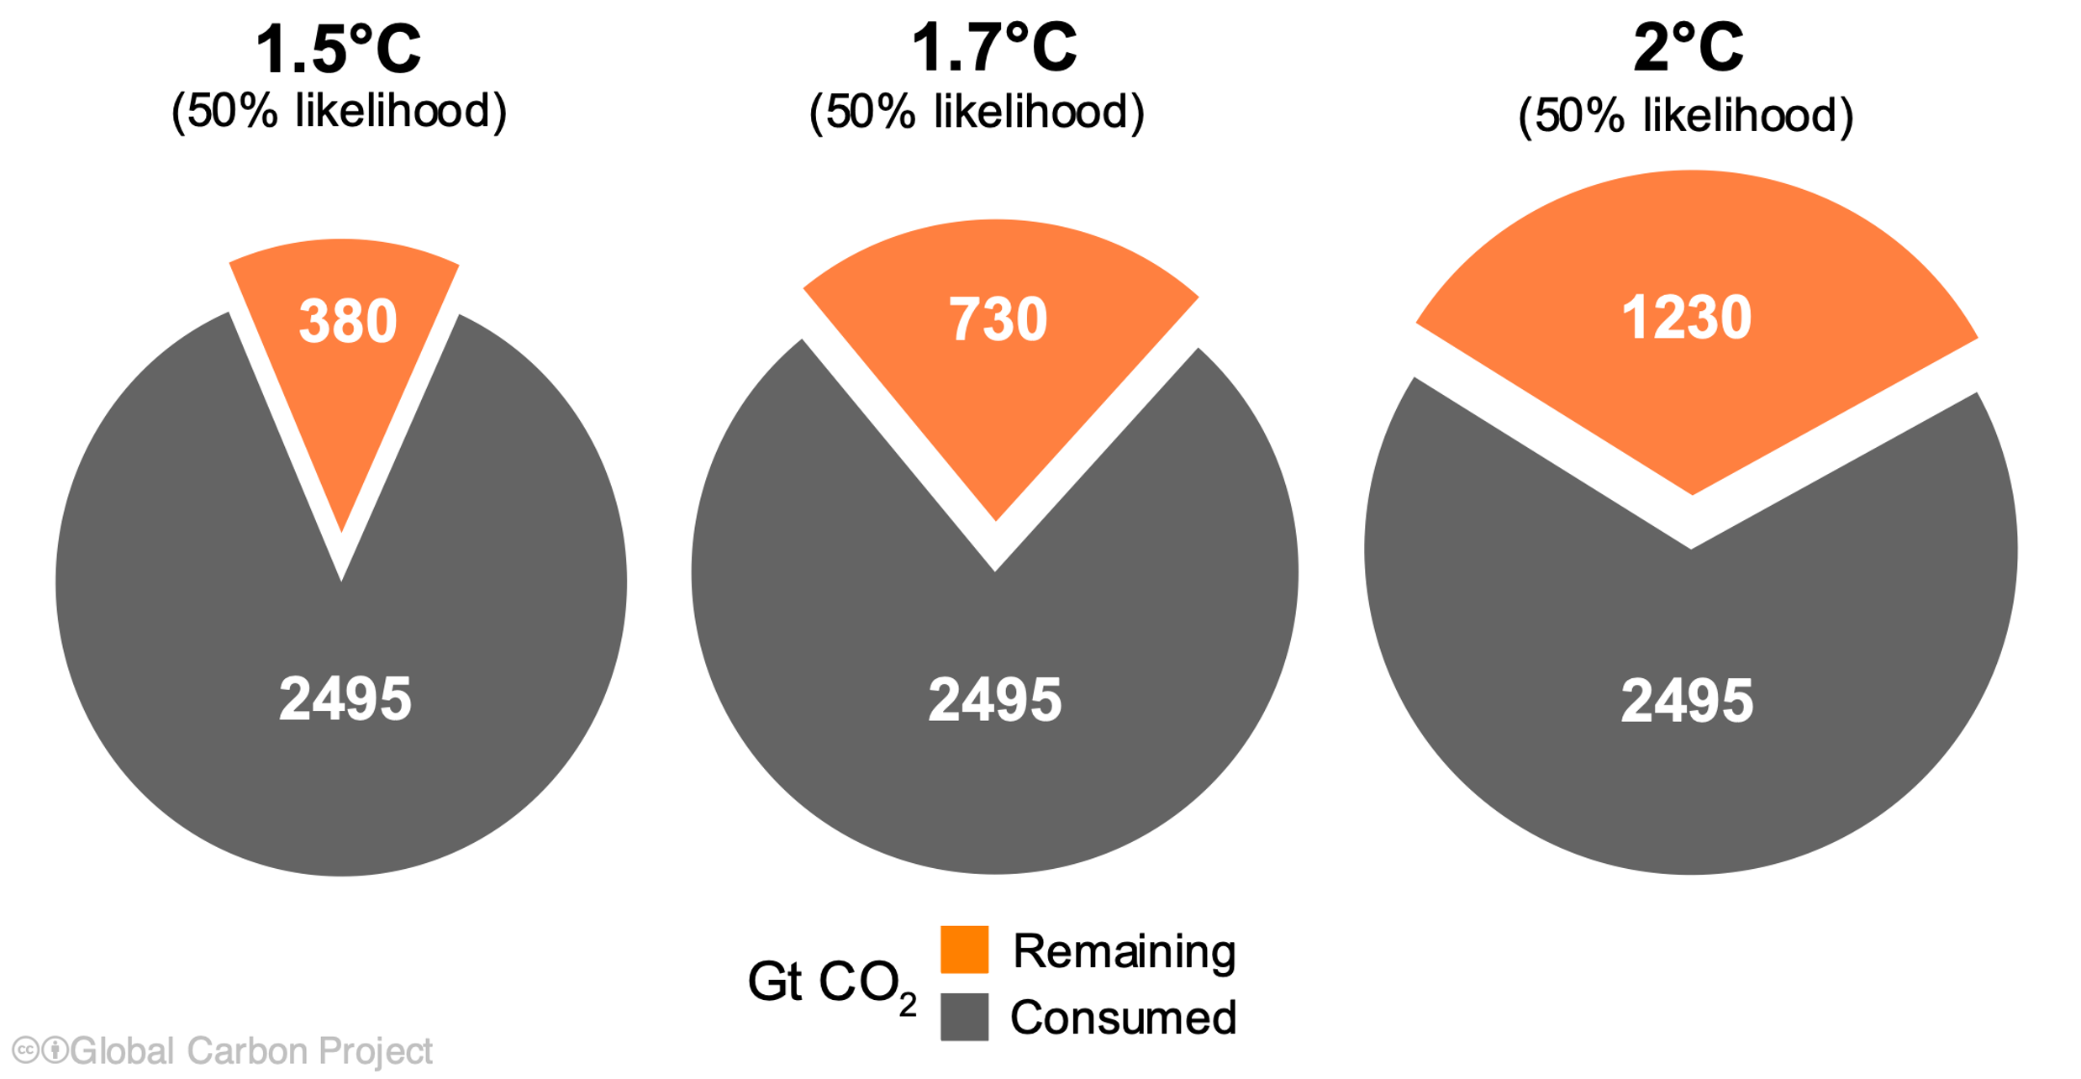
Carbon Cycle
Burn fossil fuel ➔
Atmospheric CO₂
increases ➔
Temperatures rise
PLANTS
HUMANS
ANIMALS
Credit: K2P
Carbon Budget, 2023
How much more FF
can be burned to stay
within Temp. limits?
Design renewable energy
transition roadmaps
Credit: GCP
Notes:
Our usual paradigm - There is a C cycle on top, through its natural operation we end up with some carbon underground as fossil fuels and some in the atmosphere, and now humans are extracting the buried carbon and transferring it to the atmosphere in the form of CO2, where it heats us up. Then using climate models we have a carbon budget. Very powerful concept. But now we also need to think explicitly about the energy balance.

Slide 4
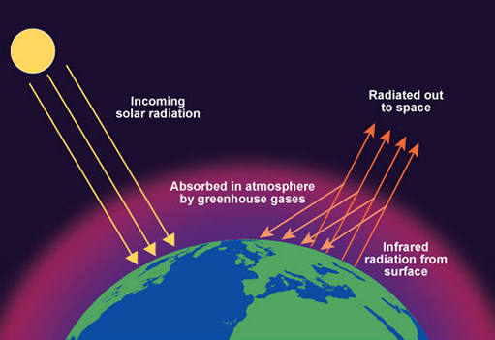
Earth’s energy balance
Sunlight
UV, VIS
IR
Earthlight
[long wave-
length]
High-energy sunlight (visible and ultraviolet) strikes Earth
Earthlight shines back into space (low energy infrared)
When input energy = output energy ➔ constant temperature
MORE greenhouse gas absorbs Earthlight ➔ ENERGY IMBALANCE
Notes:
Basic energy balance idea – Earth is shining. Natural imbalances occurred over geologic time, but pretty stable over the past 10,000 years. Now by adding GHGs, more IR is absorbed so less gets out ➔ Sunlight in is greater than IR out.
One thing is missing here though – the reflection of some of the sunlight.

Slide 5
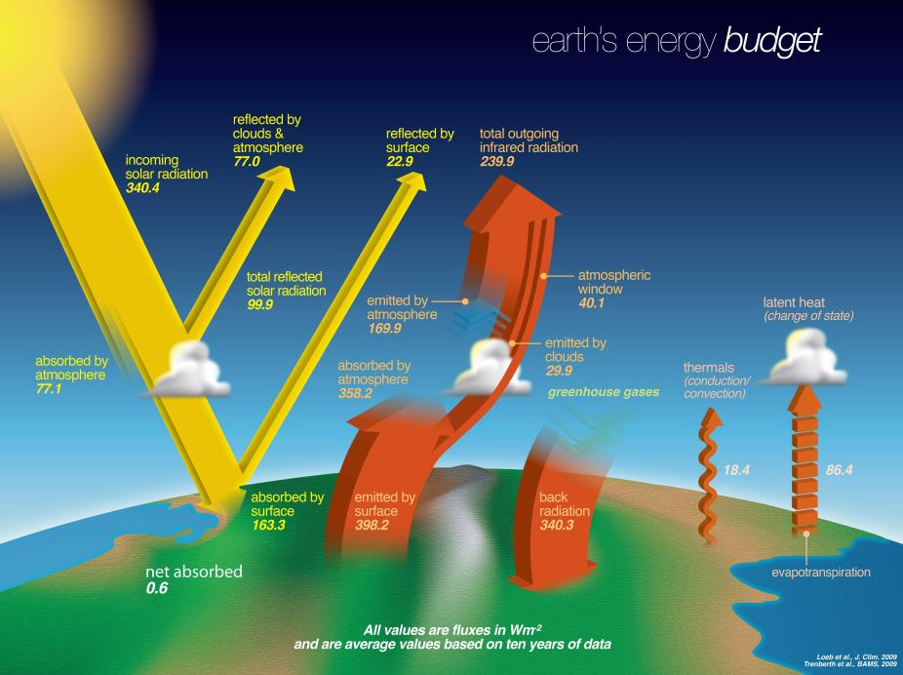
Accounting for reflected sunlight in energy balance
340.4-77.0-22.9
= 240.5 INPUT
239.9 OUTPUT
WATER
CYCLE
Credit: NASA
There is an energy imbalance: net energy absorbed = 0.6 W/m²
Based on ten recent years of data
Notes:
Sunlight yellow. Earthlight orange. Some sunlight is reflected. Reflected sunlight – just as if it never shone on us in the first place. Input sunlight minus reflected sunlight = input energy. Input energy greater than output energy. So energy imbalanced. So temperature rising.

Slide 6
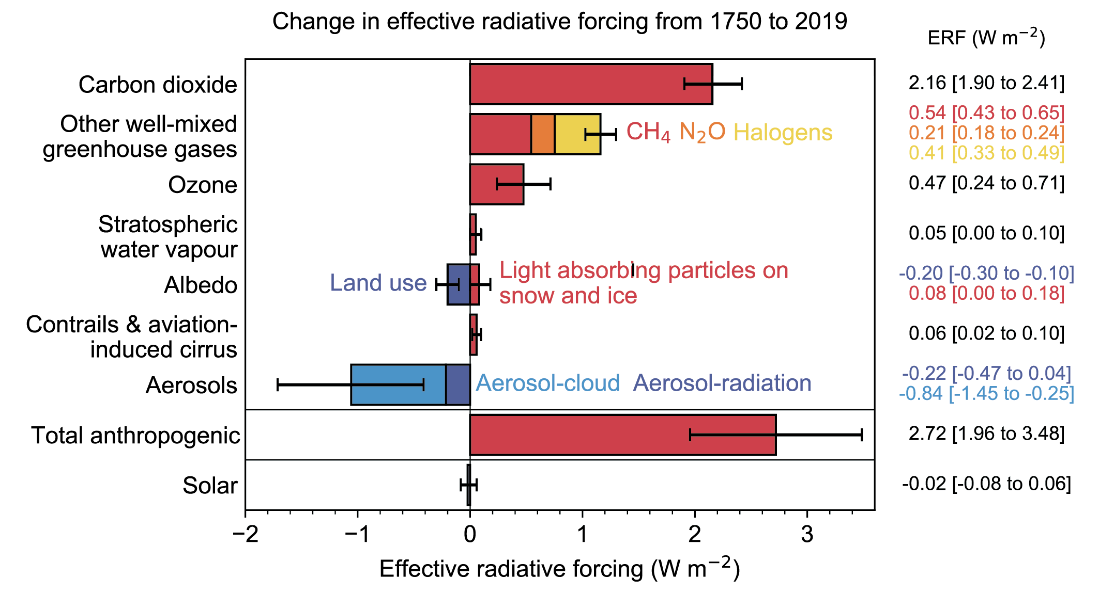
Energy imbalance since 1750: 2.72 W/m²
Drivers:
IPCC6 WG1, 2022
Earth’s energy imbalance is now ~1% of energy flux (2.72 W/m²)
CO₂ is the dominant influence
Note the cooling effects of aerosols and land use change
Notes:
I will come back to the cooling effects. Here just emphasize the 2.72 number and the primacy of CO2 and the easy to read bar chart indicating the relative contributions

Slide 7
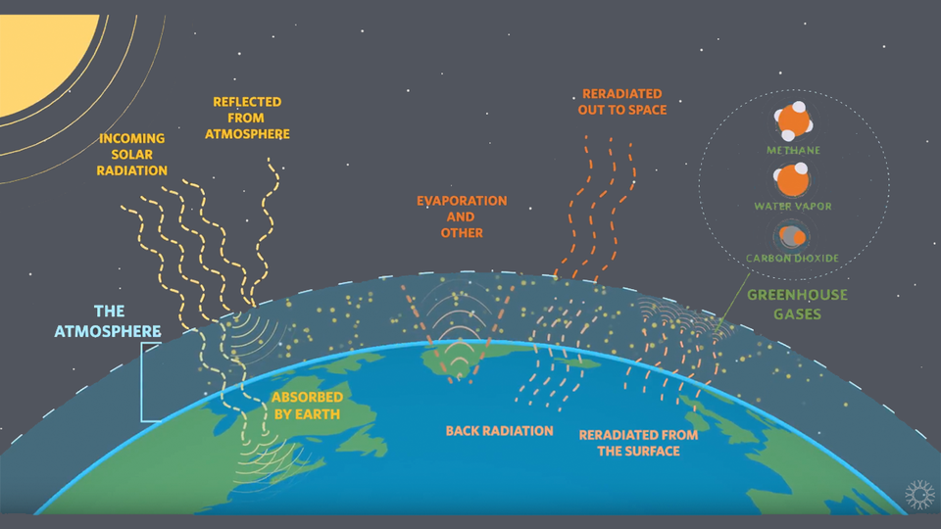
Leverage points in Earth’s energy balance
Credit: CA Academy of Sciences
Remove greenhouse gases from the atmosphere
Modify clouds to allow more Earthlight to escape
Reflect more incoming sunlight
Notes:
Now we get into geoengineering. It’s not just the carbon cycle, its also the reflectivity of sunlight and the overall energy balance.

Slide 8
What determines how much sunlight is reflected?
30% reflected
Credit: NASA
Albedo = reflectivity ~ 30%
Notes:
Here’s that slide again. About 30% of incoming sunlight is reflected. What controls that? (This is a very fast slide).

Slide 9
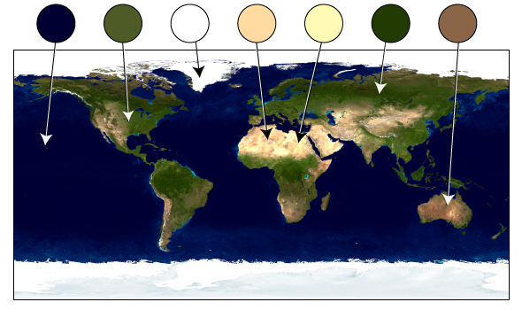
Earth’s albedo – a key climate variable
Credit: UCAR
Different surfaces reflect/absorb sunlight to their own extent
Fresh ice/snow – albedo ~90%; Forests – albedo ~15%.
Overall albedo of Earth = 30%
Human land use changes affect albedo ➔ influence E balance
Notes:
Next slide repeats bar graph, show cooling from forests

Slide 10
Albedo changes: human land use, black soot
IPCC6 WG1, 2022
Land use albedo effect: cooling, mainly from deforestation
Land use change contribution to warming today ~ 10%

Slide 11
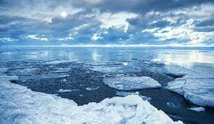
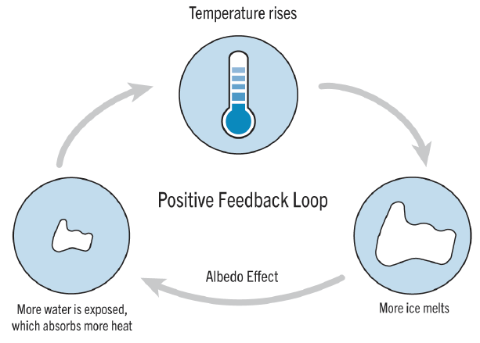
Ice albedo positive feedback loop
Burn fossil fuels ➔
Increase atmospheric [CO₂]➔
Increase melting of ice➔
White ice (albedo ~0.9)
turns to blue ocean (albedo ~ 0.2)
More heat absorbed
More ice melts, etc.
Credit: K2P
Notes:
Just to give an idea of the power of the albedo.

Slide 12
Albedo changes: aerosols; cloud-aerosol interaction
IPCC6 WG1, 2022
The other and much larger effect on cooling is aerosols.
Adding aerosol is the basis for solar geoengineering
Notes:
If it weren’t for the aerosol cooling, the total anthropogenic bar would extend farther to the right. As fossil fuel use diminishes, the aerosols will also diminish and the cooling bar will get smaller.

Slide 14
What is geoengineering?
Credit: CA Academy of Sciences
What counts as “geoengineering”?
Is geoengineering adaptation or mitigation?
Does geoengineering get at the root of the climate problem?
Notes:
Now I want to try to define geoengineering and its relationship to other climate technology.

Slide 15
Climate adaptation: coping with the problem
…addresses the consequences of climate change, not the cause
Prepare ahead for greater impacts:
increasingly intense heat waves, storms, other weather events
Build seawalls and other infrastructure for sea level rise
Pay attention to equity, since frontline communities
often lack the resources to cope with greater impacts
Foster resilience by creating local support networks
Anticipate novel, climate-related public health issues
Notes:
In the scope of climate technology, there is a range of methods we call adaptation. Which address consequences, not cause. Can be very simple, community resilience, taking care where the impacts are greater

Slide 16
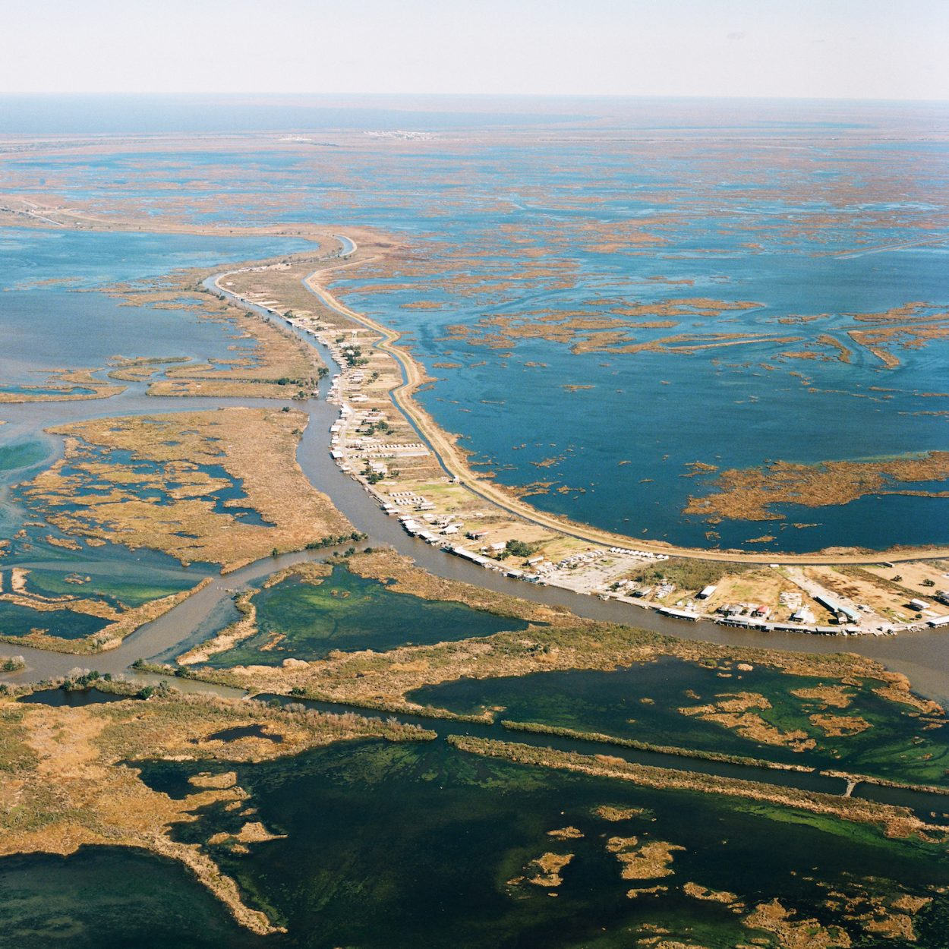
The most expensive
climate change
adaptation project
in the US - Louisiana
Highest rate of sea level rise on Earth, in part from Gulf drilling
$50 billion dollar cost, only partly financed
Over 135 separate projects (levees, barrier reefs etc.)
Sacrifices some land for other land (New Orleans)
Beachfront fishing community
with possibly limited future
https://coastal.la.gov/our-plan/2023-coastal-master-plan/
Notes:
An example of adaptation. Imagine $50 billion as compared to the Oregon budget.

Slide 17
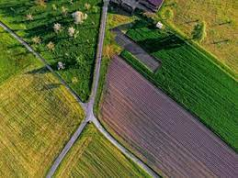
Heat management: local albedo enhancement
Paint urban roofs white
Brighten asphalt/pavement
Reduces urban heat islands
Health benefits
Energy savings
Credit: Climate Institute
No-till farming: crop residues have higher
albedo than bare ground
Changes to phenology (timing of
plant life cycles) – program high albedo
when temperatures are high
Plant breeding to enhance reflectivity:
traditional/genetic engineering
Credits: Reflective Earth;
Nature Geoscience 11, 88 (2018)
Notes:
Here’s more adaptation that brings us closer to our subject today.

Slide 18
Climate mitigation: reduce/eliminate
the drivers of energy imbalance
…directly addresses the causes of climate change
Convert electricity grid to low/zero carbon power sources:
solar, wind, nuclear, hydropower, geothermal
Switch to low carbon fuels: hydrogen, renewable diesel,
sustainable aviation fuel
Design energy-efficient buildings heated with electricity
Use alternative, low-carbon materials in manufacturing,
industry, commercial and residential sectors
Notes:
OK so then we have mitigation, directly addressing causes (drivers). We have a process or product that depends on fossil fuel and we switch away to reduce or eliminate the GHG emissions.

Slide 19
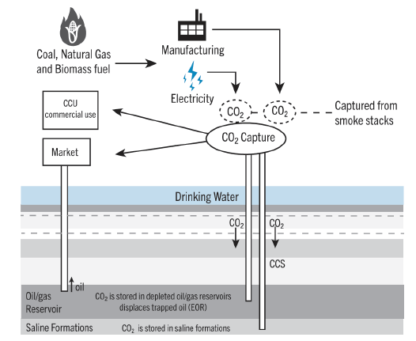
Carbon capture & storage (CCS)
CCS in industry:
mitigation
Smokestack gas
contains about
5-15% CO₂
[Atmosphere:
0.04% CO₂]
Credit:K2P
Captured CO₂ from hard-to-electrify manufacturing industries
can be permanently and safely sequestered in geologic reservoirs
Notes:
Here is something else that falls in the category of mitigation. Cement, steelmaking, petrochemicals, fertilizers, glass making, hydrogen production, etc – all fit here. Possible today because of very high CO2 level in smokestack gases.

Slide 20
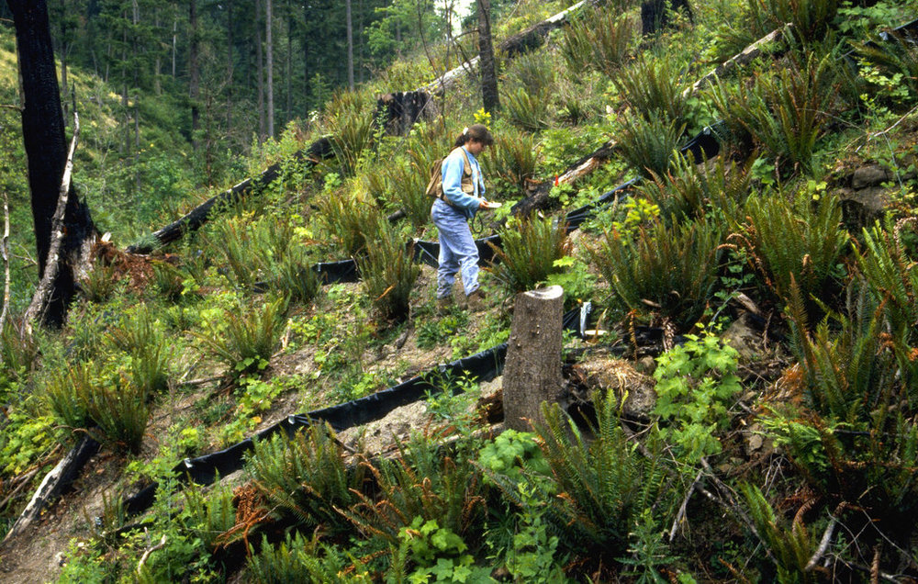
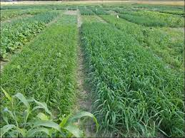
Adaptation/mitigation in forests, farms, grasslands
Switch to more drought –tolerant crop varieties (adaptation)
Conservation tillage to avoid carbon loss from soils (mitigation)
Introduce longer logging rotation times (mitigation)
Protective forest practices to reduce wildfire spread (adaptation)
Notes:
Now we can also do adaptation and mitigation on natural lands. They can work together – eg, switching to drought tolerant crops means that crops still grow, land does not go barren, more carbon is kept in the soil. Another example: protective forest practices not only save infrastructure at urban/rural boundary but also keep carbon in the soil.

Slide 21
Afforestation/reforestation – let’s plant 3 trillion trees
Reforestation potential
(Historically forested;
now unforested).
Credit: Fargione et al., 2018, Science
Is this adaptation? Is it mitigation? Is it geoengineering??
In cities, new tree planting is adaptation/mitigation
alleviates the urban heat island effect, stores some carbon
Globally, large scale afforestation aims toward
atmospheric carbon drawdown: neither adaptation nor mitigation,
but gets at the root of the problem
Notes:
But now what about this? Is this geoengineering? Mitigation is about things we’re already doing to change them into green, but this is contemplating a whole new global effort at drawdown.

Slide 22
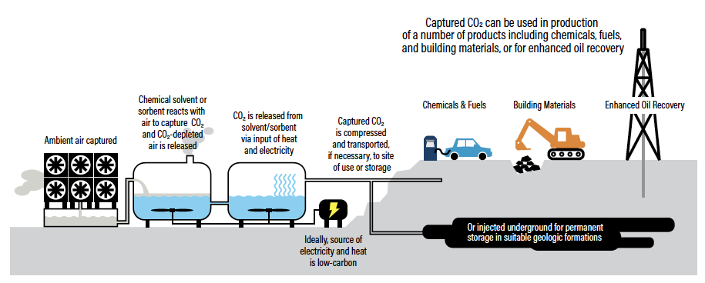
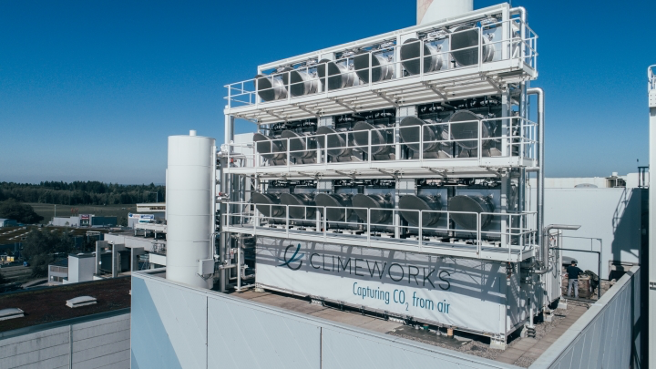
Direct Air Capture and Storage (DACS): geoengineering?
Credit: WRI, Carbon Shot (2020)
Overlapping technology with industry CCS
Near unlimited potential
Gets at the root of the climate problem
Credit: ClimeWorks
Notes:
This isn’t adaptation or mitigation either. This is solving the problem via industrial engineering. Very very tough, huge energy input needed to concentrate the carbon dioxide. Doing the same thing as planting 3 trillion trees. And if DAC doesn’t work, maybe enhanced weathering or an ocean-based approach.

Slide 23
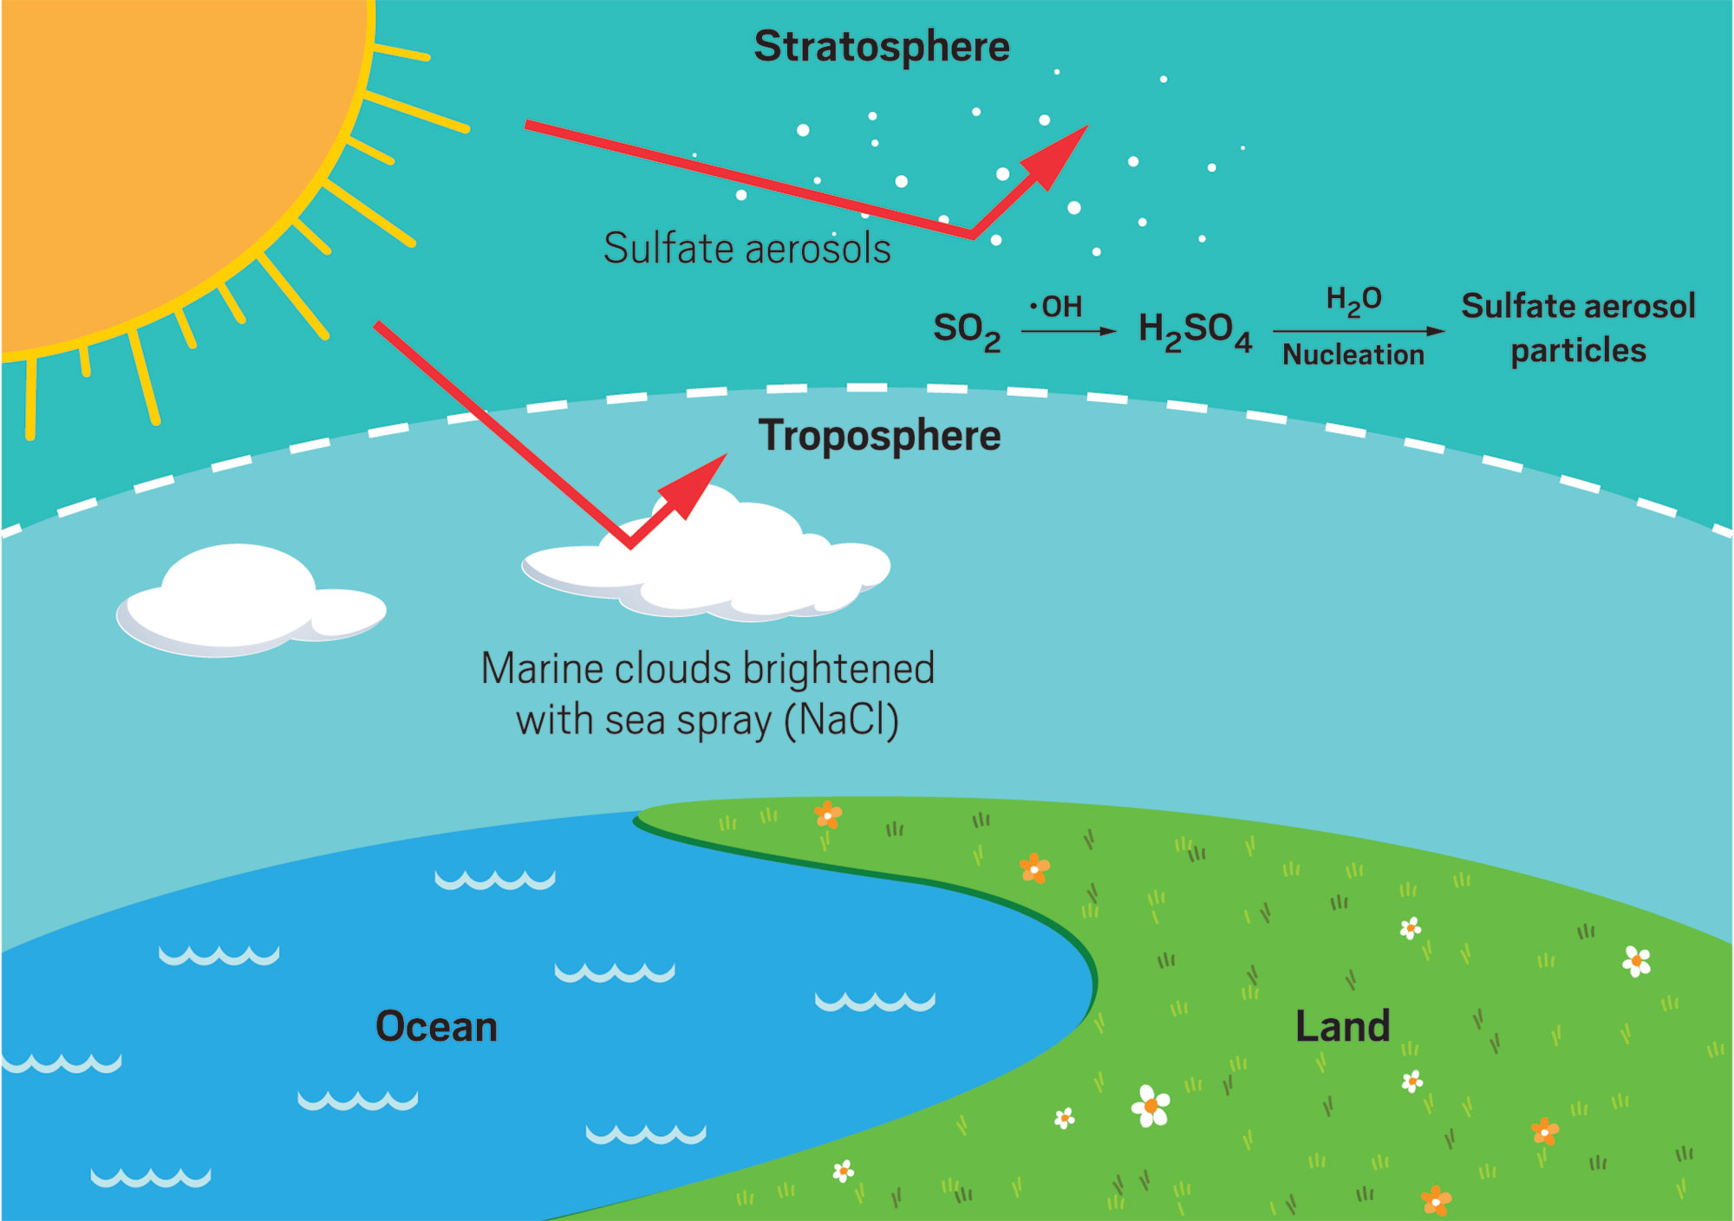
Distinguish: atmospheric albedo modification
Modify atmosphere
to increase reflection
of sunlight ➔ cooling
Global scale heat
management is
adaptation, akin to
local albedo modification
Credit: Chemical & Engineering News
Geoengineering - adaptation at a global scale
We cool off, but without addressing the root cause of climate change
Notes:
So, we might say that the 3 trillion trees, the DAC and the solar reflection projects are all geoengineering, but the first two get at the root cause of climate change by removing atmospheric CO2, while the third does not.

Slide 25
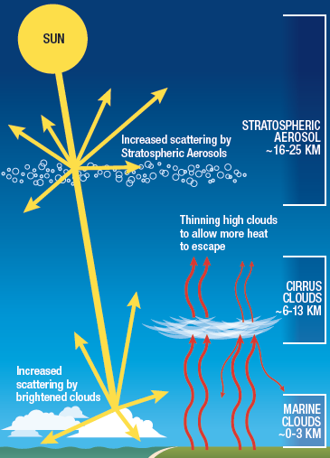
Three atmosphere-based
interventions
Stratospheric aerosol injection:
reflect more solar radiation
[solar geoengineering]
Marine cloud brightening:
reflect more solar radiation
[solar geoengineering]
Cirrus cloud thinning:
increase the amount of
Earthlight that escapes
Why are we even
considering this??
Credit: NAS Geoengineering, 2021
Notes:
OK, so let’s start looking at the actual technologies that are proposed. First, why do this at all?

Slide 26
Large projected increase in impacts from 1.2$°$C to 2.5$°$C
UN, IEA project 2.5$°$C – 3.0$°$C with present policies
Credit: IPCC 1.5
Coral reefs heat wave uneven: $$$ large, abrupt
Arctic heavy rain soc justice physical irreversible
Biodiversity drought exposure/ degrad. ice sheets melt
hotspots wildfire vulnerable ecosystem
floods loss
Notes:
As T rises we have more and more impact. Worst case avoided but present projection from UNEP, IEA of 2.5-3 degrees is still above what is shown on this slide. We need to have all options researched in case we need them.

Slide 27
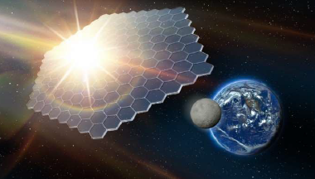
SAI
Atmosphere modification:
three main approaches
Solar shield – mirrors in space:
perhaps enabled by space
payload technology
All approaches are envisioned
as complements to emissions
mitigation - not a substitute
CCT
MCB
Credit: NAS Geoengineering, 2021
Notes:
Now, in addition to modifying the atmosphere, another project that has been explored is space mirrors. Make sure to note complementary to mitigation, not a replacement.

Slide 28
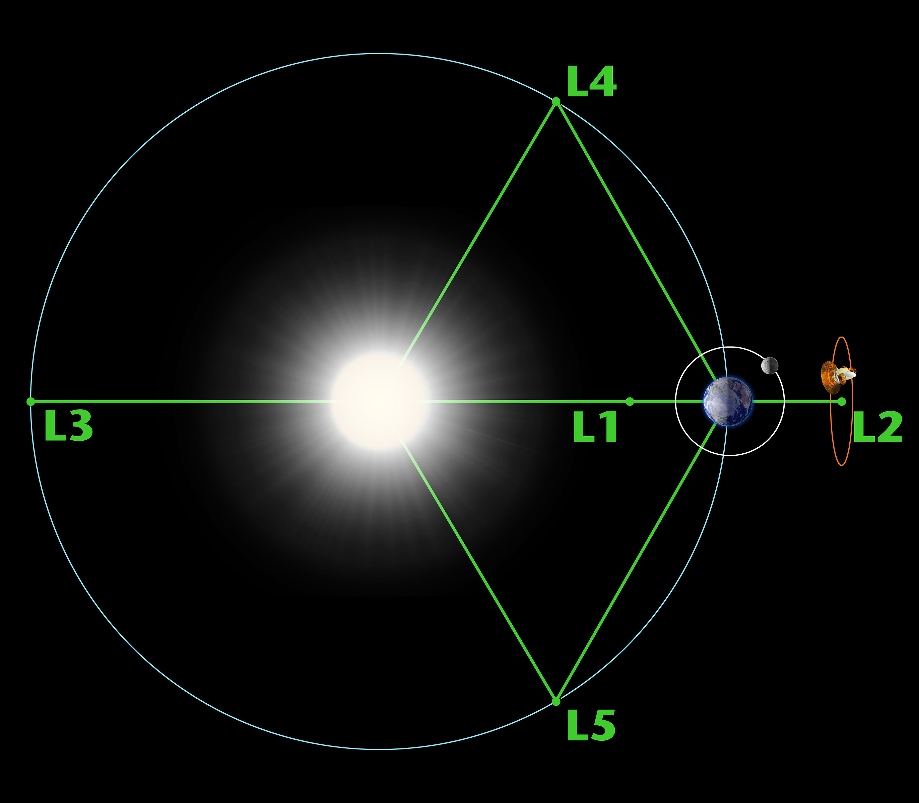
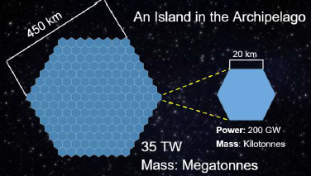
Space mirrors – a solar shield
Would be positioned at L1 Lagrange Point
Less invasive than aerosol deliveries
Enormous size needed to reflect away
enough sunlight for measurable cooling
(~3 million square kilometers)
1-2% reduction in incoming Sunlight could
reduce surface temperature by 1-2$°$C
Launch pieces into 2000 km orbit, solar
radiation pressure ➔ L1 point (solar sail)
(OR assemble on lunar surface)
Estimated cost: $2-4 trillion
Planet sunshade island
22 islands ~ RCP1.9 (1.5 $°C)$
C. Fuglesang et al., Acta Astronautica 186 (2021) 269-279; R. Centers et al., 71st Intl. Astro Conf. (2020)
Notes:
Lagrange point – objects stay there, gravitational pull of Sun/Earth balanced by centripetal force. One degree reduction ➔ 1 degree cooling is pretty accurate. L2 = James Webb telescope. Might take many decades to build, huge materials cost, mine the moon for materials etc. Pretty nuts, really.

Slide 29
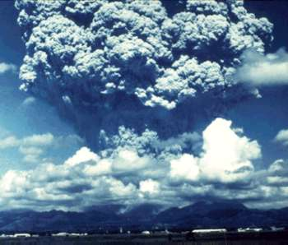
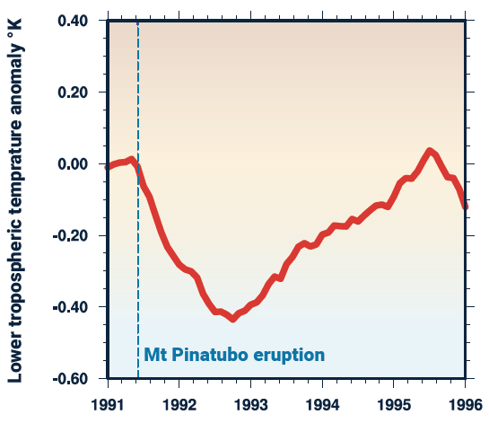
Mt. Pinatubo: Natural stratospheric aerosol injection (SAI)
Before eruption
1 month after
Pinatubo eruption
Credit:UNEP
Credit: NAS Geoengineering
Prominent example of natural albedo modification
Large injection of sulfur aerosol particles
Global cooling ~ 0.4 $°$C
Earth albedo increase of about 0.5%
Natural analog promotes confidence
in engineered SAI, drives research
Notes:
Upper right = additional light scattering promoted by aerosols. Amount of cooling here is less than what we might need, but its not that far off. Artificial SAI would do the same thing. Note, on graph, how long it took to cool, and how long it took to warm back up.

Slide 30
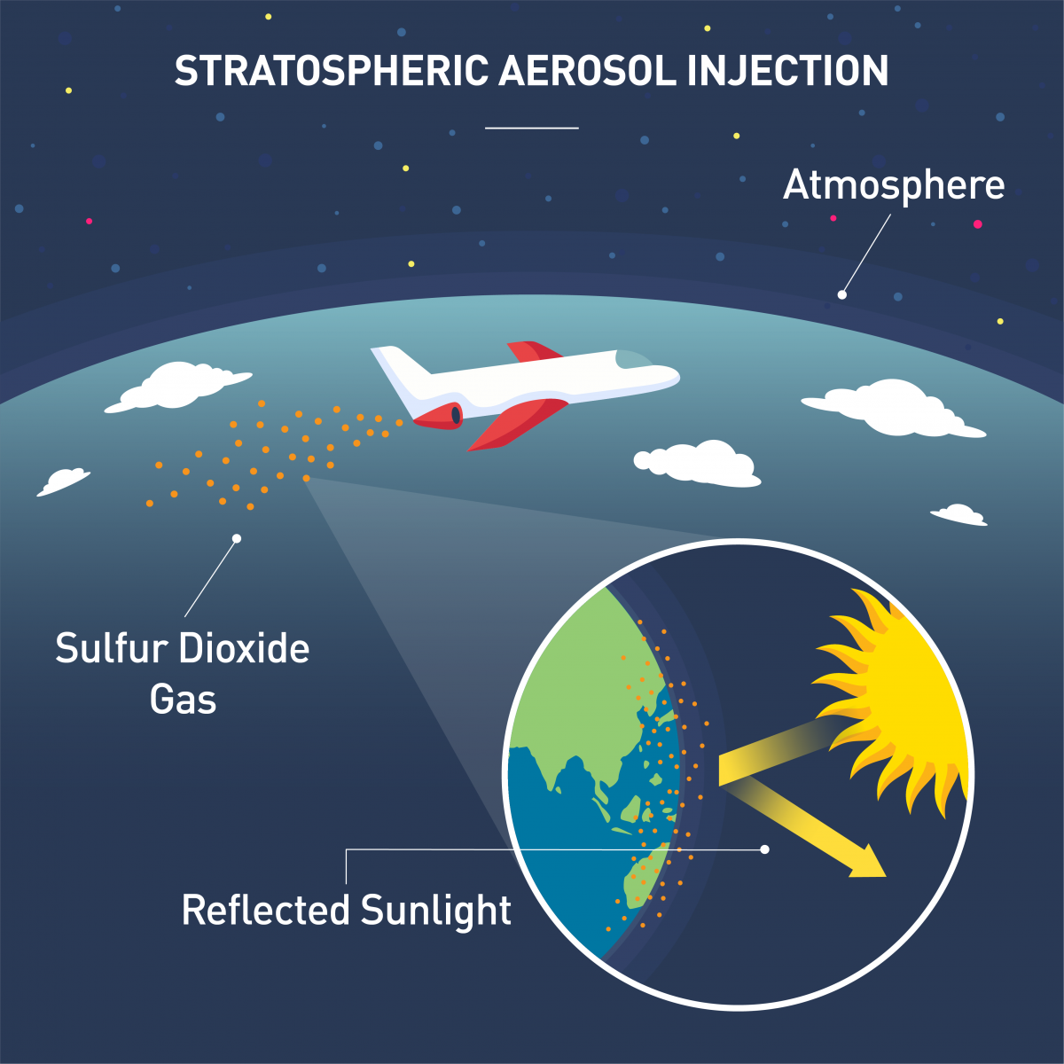
Plausible benefits of SAI
Potential to cool Earth by
several degrees within a
few years of deployment
The only known approach to
rapidly accomplish cooling
on a global scale
Affordable - Costs estimated
at tens of billions of dollars
per degree cooling per year
Feasible – no insuperable
technical hurdles identified
Credit: J. Sci. Comm. (2021)
By analogy to natural eruptions
and given known radiative
properties of aerosols, a cooling
effect is nearly certain. About 1%
of sunlight would need to be
reflected. Regional effects likely.
UNEP, 2023
Notes:
While we don’t have the infrastructure now, no clearly insuperable technical/engineering barriers foreseen.

Slide 31
How would SAI be done?
Delivery of sulfur dioxide by plane
into the stratosphere. SO₂ will
then form sulfate aerosols
Low turbulence in stratosphere
allows even spread, global reach
Release at ~20 kilometers altitude
would suffice. Estimated 4,000
flights in first year. ~ 1 Mt S/yr.
Alternatives: delivery by rockets
or balloons; use other aerosols
Credit: J. Sci. Comm. (2021)
Depending on the pace of the
net zero energy transition,
SAI would need to continue for
decades or longer
Smith & Wagner, Env Res Lett 13 (2018) 124001
NAS Solar Geoengineering, 2021
Notes:
Red italics – we saw 2 slides ago from Pinatubo that it the cooling dissipated in a few years, hence continuing to do this year after year would be required. Non-sulfur aerosols would be calcite (calcium carbonate).

Slide 32
Variables in SAI
Altitude, longitude/latitude, quantity
and season of aerosol delivery
The chemical nature of the aerosol
Regional targeting plausible (Arctic)
Iterative approach relying on
results from early deployment
Scales of aerosol processes and
aerosol/cloud interactions much
smaller than climate model grids
Credit: J. Sci. Comm. (2021)
NAS Solar Geoengineering, 2021
Z. Dai et al., Geophys Res Lett 45, 1030 (2018)
IPCC6 WG1
Notes:
Red italics – the reason we need the iterative approach is because we can’t come close to calculating the details – models are limited because the relevant physical processes take place over much smaller dimensions than the grid size. Note that there’s the aerosol radiation (reflection term) but also the aerosol cloud (much more reflection by modifying cloud properties)

Slide 33
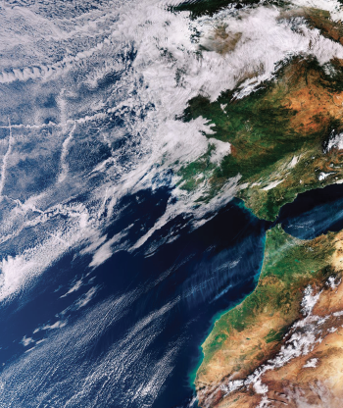
Marine Cloud Brightening
Increases reflectivity of low-lying
marine clouds
Sea salt aerosols used to produce
a larger number of smaller cloud
droplets ➔ higher albedo
Ship-based deployment; some work
on nozzles to control aerosol size
Targeted deployment for local cooling;
unclear if it can have global reach
Many possibly confounding cloud
feedbacks; much more work needed
Maritime clouds crisscrossed with
tracks from maritime vessels.
Credit: NAS Geoengineering
Notes:
Point 4 – MCB is more like weather control. Nozzle development has been done. Possibly confounding cloud feedbacks – go back a slide, see lighter blue “aerosol-cloud” has a huge error bar.

Slide 34
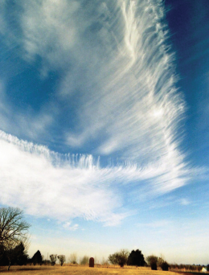
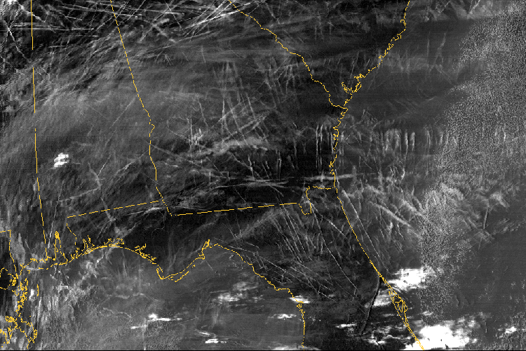
An inadvertent experiment after 9/11
Cumulus cloud
Credit: NASA
Cirrus cloud
Airplane contrails, Southeast US
Cirrus clouds reflect less sunlight but absorb more earthlight than cumulus clouds ➔ warming
Airplane contrails appear to behave similarly to cirrus clouds
After 9/11, the 3-day flight ban produced higher daytime T highs
(contrails reflect sunlight) and lower nighttime T lows
(contrails absorb Earthlight). +/- 2 degree effects.
Overall effect from cirrus clouds and contrails is warming
Notes:
Now the third solar geoengineering method isn’t really solar because it works on the Earthlight side of the energy balance. Cirrus is considered a “warming cloud”. 9/11 produced conditions for an inadvertent climate experiment

Slide 35
Cirrus cloud thinning
Thinning and reducing cirrus cloud cover is projected to have a cooling effect.
(same mechanism as greenhouse gas removal)
Cirrus clouds form by (1) growing ice around a dust particle (larger)
and (2) self-nucleation of smaller pure ice particles
The small pure ice particles absorb more Earthlight
Adding dust seeds (geoengineering) would favor larger ice crystals
and promote net cooling. Larger particles also fall out faster
A few models show cooling, but they don’t represent the cirrus
processes correctly. Very poorly understood. No work on
implementation.
NAS Geoengineering, 2021
Notes:
No studies of practical delivery methods. Suggests mitigation by changing airplane flight patterns.

Slide 37
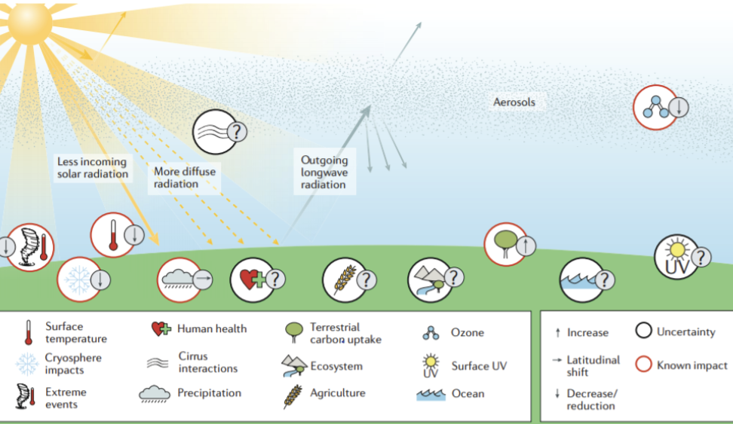
Benefits and hazards of solar geoengineering
Credit: NAS Geoengineering, 2021
Benefit: by lowering temperatures, SAI could rapidly reduce heat waves,
storm intensities, rate of sea level rise, cryosphere melting.
AC Jones et al., Earth’s Future 6, 230 (2018)
Notes:
Can go through the little icons

Slide 38
Potential hazards of solar geoengineering
Change in the relative amounts of direct vs. diffuse sunlight
-possible effects on photosynthesis, crop yields,
solar thermal electric power generation
Altered precipitation patterns
-rainfall amounts will decrease faster than would
be expected for a given temperature decrease
-potentially very large regional variations
Depletion of stratospheric ozone (SAI with sulfate aerosol)
-complex effects on atmospheric chemistry
-research on non-sulfur aerosols needed
Stratosphere heating (SAI with sulfate aerosol)
-sulfate aerosol particles absorb radiation
Notes:
Much is unknown about regional rain variations. Monsoon rains, arctic polar vertex, Amazon rainfall etc

Slide 39
Benefits and hazards of solar geoengineering
NAS Geoengineering, 2021
Potential effects on ecosystem health, agricultural yields,
human health unclear; model-dependent. Effects may be
smaller than those already brought about by climate change.
Notes:
Can go through the little icons

Slide 40
Opposition to solar geoengineering
Calls for immediate negotiation of an International Non-Use
Agreement, signed so far by 430 academics from 61 countries
Prohibit state funding of solar geoengineering technology
without affecting basic climate research
Ban all outdoor experiments and deployment
Deny patent rights for solar geoengineering technology
Object to future institutionalization as an allowed
international policy mechanism
Solar Engineering Non-Use Agreement Initiative, Solar Engineering Myths Debunked.
Briefing Note #1, January 2023.
Notes:
Because of these hazards, and for other reasons, some would like to preemptively ban any deployment.

Slide 41
Why a non-use agreement?
Huge ecological threats, massive humanitarian risks for the
most vulnerable, and fundamental geopolitical challenges
Reduces the urgency for socioeconomic transformation in
the Global North. Reinforces the marginalization of
vulnerable peoples and concentrates existing power.
Limited outdoor experiments would not be informative, and
any beginning is dangerous. The slippery slope is real.
Stable international governance is implausible. Well-intentioned
scientists will not control deployment. Unilateral action possible.
Solar Engineering Non-Use Agreement Initiative, Solar Engineering Myths Debunked.
Briefing Note #1, January 2023.
Notes:
First point connects to moral hazard generally – reduced urgency for emissions mitigation.

Slide 42
More arguments for the Non-use Agreement
SAI or MCB would not simply offset the effects of greenhouse gases,
since cooling is by a different mechanism. Climate models cannot
accurately project the consequences.
SG is in the same category as human cloning, gain-of-function viruses,
nuclear weapons, biological warfare etc. Morally impermissible
and far too risky to be worth it – especially since real solutions
to global warming are available.
Solar Engineering Non-Use Agreement Initiative, Solar Engineering Myths Debunked.
Briefing Note #1, January 2023.

Slide 43
Support for Solar Geoengineering Research
United Nations
Recommends a robust, equitable, transdisciplinary
scientific review process to reduce uncertainty (UNEP, 2023)
US Executive
Biden White House – Five year study plan begun by
the Office of Science Technology & Policy (OSTP). Follows
recommendations of NAS Geoengineering Report, 2021
US Congress
Bipartisan support for directed research funding; likely soon.
Support letter from over 100 prominent scientists.
“I suppose knowledge never hurts”
Sheldon Whitehouse (D-RI, Chair of Senate Budget committee)
“It’s emerging today and soon it will be mainstream”
Senator Kevin Cramer (R-ND)
Notes:
This is not support for deployment, just for research.

Slide 44
Solar geoengineering fails all three “Sarewitz-Nelson
rules” for technology development
The technology must largely embody the cause and effect
relationship connecting the problem to the solution
The effects of the technological fix must be assessable using
relatively unambiguous or uncontroversial criteria
Research and development is most likely to contribute
decisively to solving a social problem when it focuses on
improving a standardized technical core that already exists
-as explained by Dr. Roger Pielke, in:
“Why I support a non-use agreement
on solar geo-engineering technologies”
Sarewitz & Nelson, Nature 456, 871 (2008).
Notes:
For (2) imagine what would happen if we start SG and then there’s an extreme weather event. For all of these but especially (3) the implication is we have limited resources. But the cost of SAI is so cheap as to negate this.

Slide 45
Solar Geoengineering vs Direct Air Capture
SG DAC
Mechanism | More reflection of sunlight | Removal of atmospheric CO₂
Duration of cooling | 1-3 years (SAI) ~10 days (MCB) | Permanent
Atmospheric CO₂ Level | High levels persist | Decreases to desired level
Timescale for cooling | A few years; but must continue indefinitely | Some decades; then can stop
Adapted from UNEP, 2023
Notes:
Decreases to desired levels – some of you may want neither of these technologies, but even if best case scenario = 460 ppm is achieved, the 1.6 degree warming still has very bad impacts. At that point, we can wait for geologic time or use DAC.

Slide 46
Solar Geoengineering vs Direct Air Capture
SG DAC
Ocean Acidification | Does not improve | Improves as CO₂ degasses
Termination shock | Extreme | None
Development time to scale | ~10 years | ~15-30 years
$$$ | $10-20 billion per year | $250-$600 per ton of CO₂
Adapted from UNEP, 2023
Notes:
Termination shock – particularly strong effect on biodiversity, biome shifts.

Slide 47
Solar Geoengineering vs Direct Air Capture
SG DAC
Physical hazards | Many new hazards | Known hazards; scale-up
Societal conflict | High potential | Low potential
UN process | None yet | Works within UNFCCC/Paris
Status in US | Directed research funds likely soon | 45Q tax credit, CO₂ pipelines, EPA regulation
Adapted from UNEP, 2023

Slide 48
Thank you!
United Nations Environment Program (2023). One Atmosphere: An independent expert review
on solar radiation modification research and deployment. Kenya, Nairobi.
https://www.unep.org/resources/report/Solar-Radiation-Modification-research-deployment
National Academies of Science, Engineering and Medicine 2021. Reflecting Sunlight:
Recommendations for Solar Engineering Research and Research Governance, Washington DC.
The National Academies Press. https://doi.org/10.17226/25762
www.fromknowledgetopower.com; https://www.linkedin.com/in/johnperona/
johnjperona@gmail.com

