Slide 1
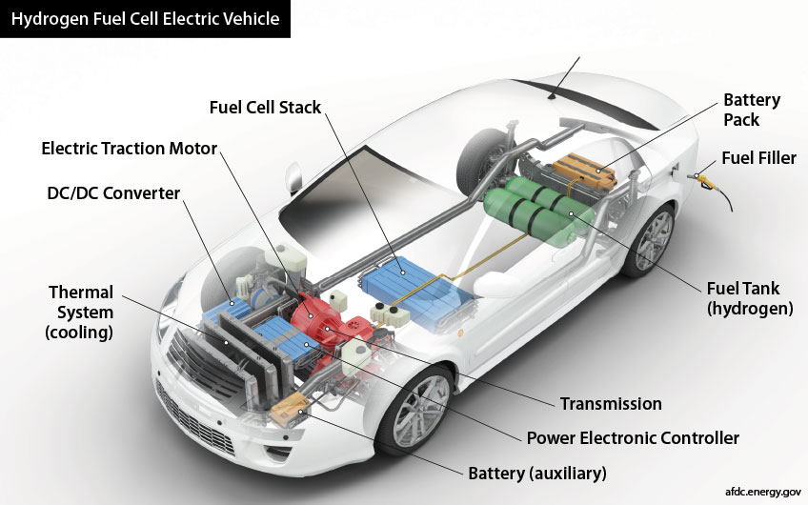
Hydrogen and the net-zero energy economy
John Perona
Metro Climate Action Transportation Team
7 May 2021

Slide 2
Hydrogen and the net-zero energy economy
What is hydrogen?
How is hydrogen manufactured?
What is hydrogen used for?
How can hydrogen be integrated into
the net-zero energy economy?
(production, storage, transport)
Policies to promote blue and green hydrogen

Slide 3
A Wee Bit of Chemistry
Methane Methanol Formaldehyde Formic acid Carbon Dioxide
CH₄ CH₃OH CH₂O HCOOH CO₂
most reduced …..…………..………………….. most oxidized
highest energy …….…………..…………………. lowest energy
High energy, reduced compounds combine
with oxygen [burn] ➔ release (useful) energy
as they are converted to low energy compounds
CH₄ + 2O₂ ➔ CO₂ + 2H₂O burning CH₄ releases energy + CO₂ + water
2H₂ + O₂ ➔ 2H₂O burning H₂ releases energy + water, no CO₂

Slide 4
Properties of Hydrogen as an Energy Carrier
Data from IEA
Carries chemical energy (H₂ molecule); not electrons flowing
Storage and transport as a stable chemical; stocks not flows
Chemical reactions: industry feedstock; produce other energy-rich molecules
Very light and found as a gas at ambient conditions
Very high energy per unit of mass, but very low energy density
Can be compressed for transport and storage (but energy cost)
Health and safety concerns (unfamiliar risks)

Slide 5
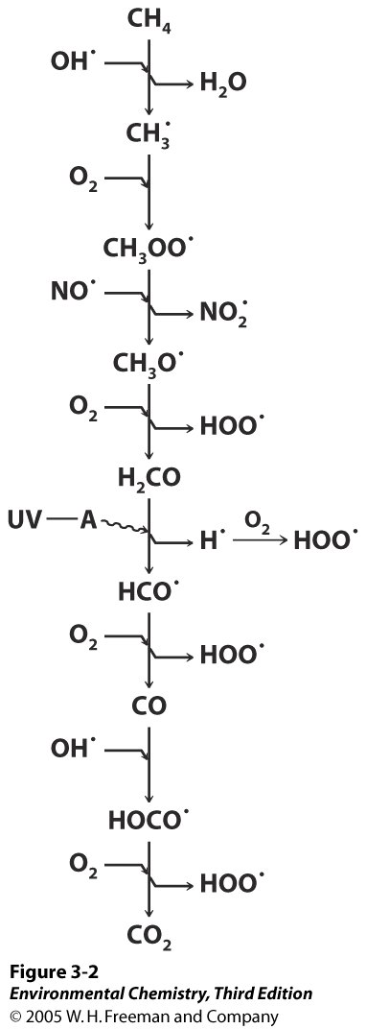
Hydrogen (H₂) is an indirect greenhouse gas
Could widespread hydrogen use
cause further warming??
H₂ reacts with OH. radicals; increases ozone, methane levels
Ozone and methane are both greenhouse gases
H₂ can escape atmosphere, but the main sink is soils
H₂ concentration ~ 0.5 ppm [methane = 1.9 ppm]
Atmospheric lifetime of H₂ ~ 2 years
Global warming potential ~ 5 (100 yrs) [methane = 28]
If H₂ fully replaces fossil fuels, and 1% leaks, the climate
impact is estimated at 0.5% of present CO₂ emissions
RG Derwent et al., , Int. J. Hyd. Energy, 45, 9211 (2020)

Slide 7
Hydrogen and the net-zero energy economy
What is hydrogen?
How is hydrogen manufactured?
What is hydrogen used for?
How can hydrogen be integrated into
the net-zero energy economy?
(production, storage, transport)
Policies to promote blue and green hydrogen

Slide 8
How hydrogen is produced
Resources for
the Future,
Feb 2020
In the US, most H₂ is produced from natural gas by reforming (gray)
Blue hydrogen may not be fully decarbonized

Slide 9
Global Annual Hydrogen Production ~ 120 Mt
(120 Mt = 120 million metric tons = 120 billion kg)
96.7% Gray/Brown
1.9% Byproduct
1.1% Blue (CCS)
0.3% Green
Eats up 2% of global
energy demand
Coal source dominant
in China
Credit: Global CCS Institute, Blue Hydrogen, April 2021

Slide 10
Making Hydrogen – CO₂ emissions of various pathways
22 kg CO₂/kg H₂ (worst case)
Natural gas
reformation
Coal gas.
Grid run
on gas
BECCS
Credit: Global CCS Institute, Blue Hydrogen, April 2021
Hydrogen production generates ~2.2% of world CO₂ emissions

Slide 11
Making hydrogen from methane
Steam-methane reforming: 700-1000 ◦C, low pressure, catalyst
First reaction produces a CO / H₂ mixture called syngas
Syngas can also be made by heating biomass
Syngas (synthesis gas!) is a feedstock for chemicals, etc
The second reaction produces more H₂
Purification is needed for some end uses
Relative amounts of CO, CO₂, H₂ can be fine-tuned

Slide 12
Capture and geologic storage of CO₂ is essential to blue hydrogen development
CO₂ is scrubbed from the H₂ smoke stack emissions
CO₂ is injected deep underground
Works in many industries
Only at Mt scale/year now; needs 1000x scaleup
Key challenge: economics
A Four Step Process
Capture
Compression
Pipeline
Transport
Underground
Injection

Slide 13
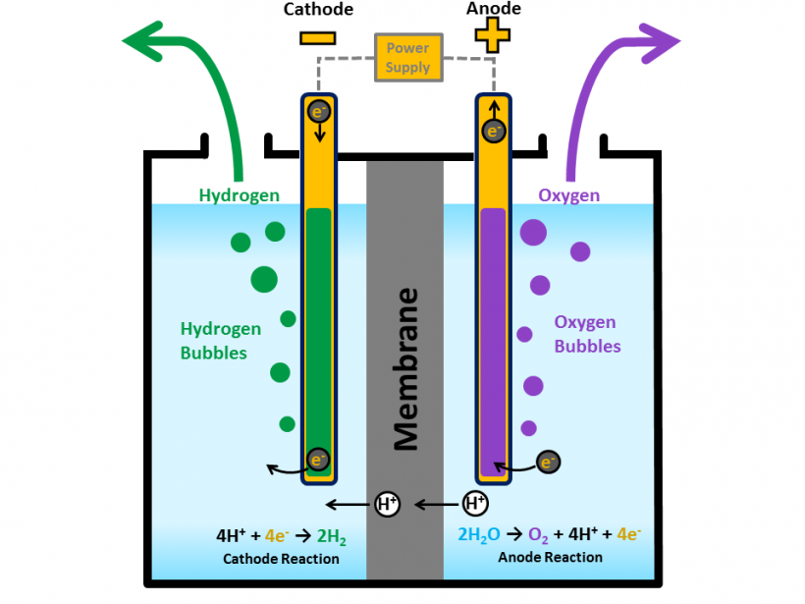
Hydrogen production by electrolysis
2H₂O ➔ 2H₂ + O₂
[reverse of H₂ burning]
Generates very high purity H₂
If all global H₂ by electrolysis➔
~4Twh (~total US electricity use)
AND would use 1.3% of world’s
energy industry water demand
Three distinct technologies
exist (vary in electrode material,
membrane, need for heat)
Credit:
DOE
Reduction at
cathode
Oxidation at
anode
Credit FCHEA
Credit AIChE

Slide 14
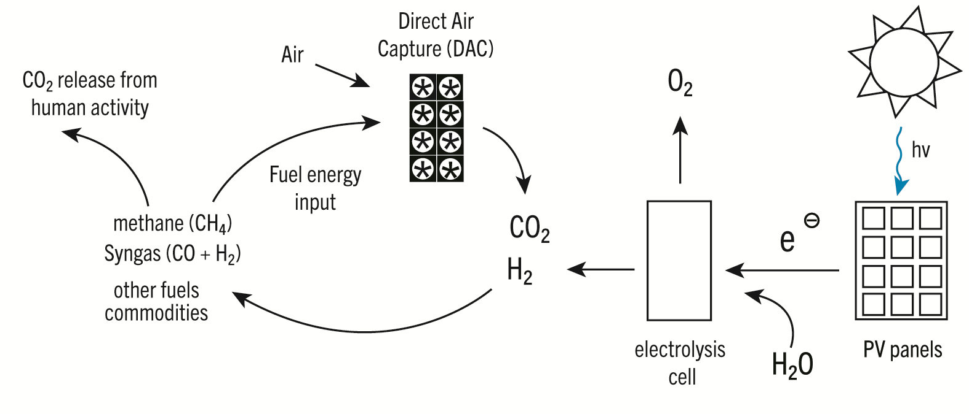
Circular carbon economy (holy grail)
K2P, 2021
Green H₂ production from renewable electricity
Direct air capture of CO₂ (large energy requirement)
Syngas and fuels production by combining CO₂ and H₂
Recapture CO₂ from burning the synthetic fuels
Biomass harvesting is not required

Slide 15
Feel-good story
Surplus Columbia River hydroelectricity
will be used to generate hydrogen
This is a pilot project
May produce 2 tons of green H₂ per day
Electrolyzer needs 5 MW power
(Wells Dam = 840 MW capacity)
Total US H₂ needs: 57,000 MW

Slide 16
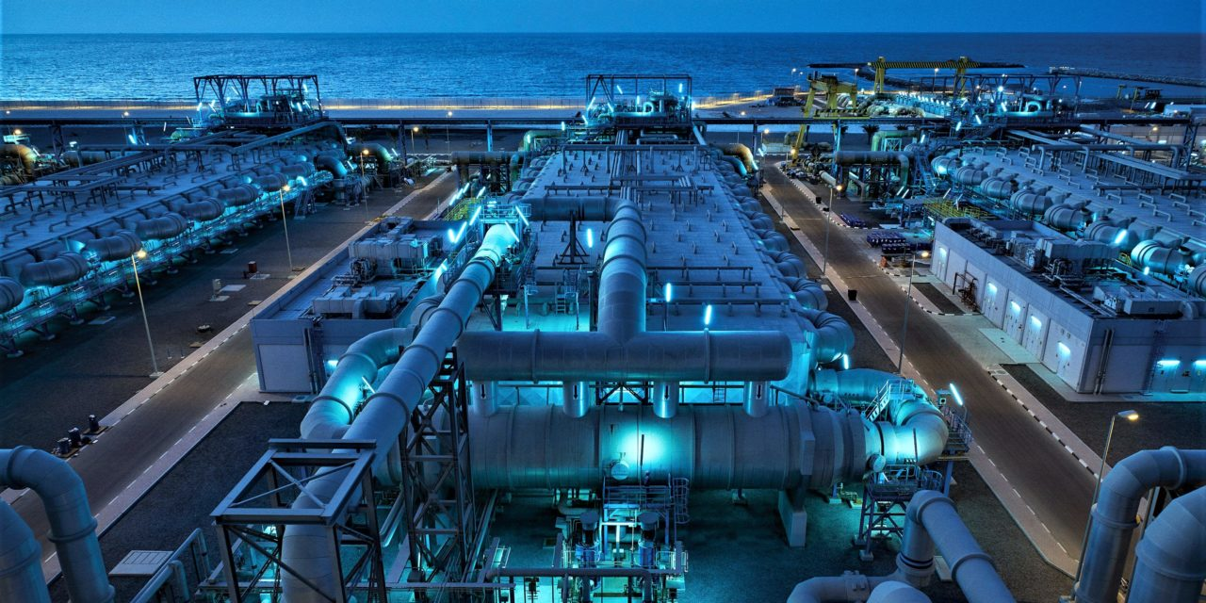
Desalination plant, Dubai – plans to convert to solar power
Credit: Popular Science
Hydrogen production from seawater – bench scale only
Freshwater resources may constrain development
in water-stressed regions
Reverse osmosis (desalination) energy cost is modest
Some detailed analysis needed here

Slide 17
Relative costs of gray vs. blue vs. green hydrogen
Credit: Resources for the Future, A Hydrogen Future,
Exploring Pathways to Decarbonization, March 9, 2021
Crucial factors for green hydrogen development: electrolyzer cost,
capacity factor for electrolysis facilities, and price of electric power

Slide 18
Green hydrogen costs vary with
costs of renewable electricity
IEA, The Future of Hydrogen, June 2019

Slide 20
Hydrogen and the net-zero energy economy
What is hydrogen?
How is hydrogen manufactured?
What is hydrogen used for?
How can hydrogen be integrated into
the net-zero energy economy?
(production, storage, transport)
Policies to promote blue and green hydrogen

Slide 21
Hydrogen Use
DRI = direct reduced iron - steel production
Refining/Ammonia/Other Pure – need pure H₂
Methanol/DRI/Other mixed – H₂ in a mixture
Not pictured: Energy Storage; Industrial Heat; Vehicles
IEA, June 2019

Slide 22
Breakdown of hydrogen production and use
Credit: IEA

Slide 23
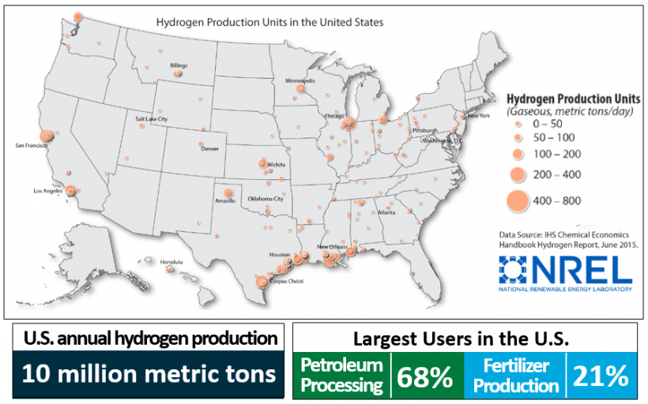
Hydrogen production in the US, 2018
Only ~1600 miles of H₂ pipeline in the United States
Most H₂ is used at the site of production

Slide 24
Hydrogen is required for producing fossil fuel products
Heavier fuel oils are “cracked” at high temperature ➔ useful lighter products
Hydrogen reacts with the fuel oils, controls breakdown and temperature

Slide 25
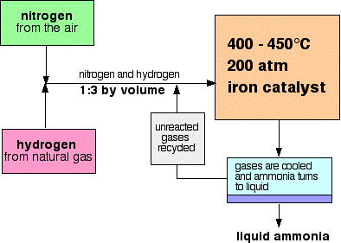
Haber Process for Ammonia Production
Credit: Chemistry LibreTexts
Ammonium salts are the basis for fertilizers
Haber Process ➔ Green Revolution ➔ Human population growth

Slide 26
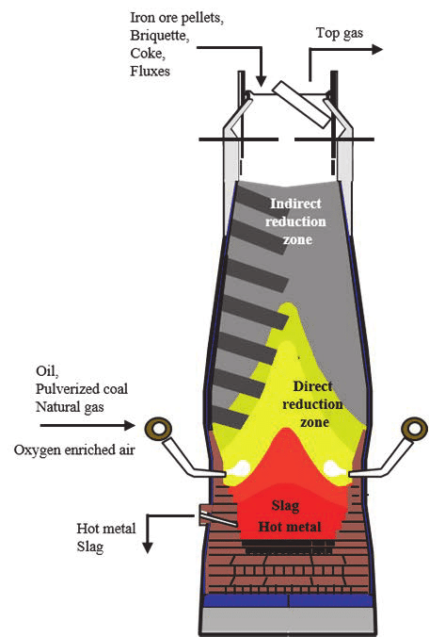
Hydrogen Use in Steelmaking
CO from syngas
(fossil fuel)
H₂ from syngas
or renewables
Iron oxides (Fe₃O₄, magnetite or Fe₂O₃, hematite)
are the forms of iron found in most mined iron ore
But reduced iron (Fe) is needed to make steel
Steelmaking also requires carbon from coking coal
(10-15% of coal mined is used for this)
Credit: Hannu Suopajarvi

Slide 27
Industrial Heat – Key to Reducing Industry Emissions
Data from CGEP
Potential “green” alternatives for supplying industrial heat
Temperature requirements for various industries differ
Hydrogen can meet all industry requirements. But no pure H₂ used today.

Slide 28
Hydrogen for Energy Storage on the Electricity Grid
Ctr. for Sustainable Systems
Univ. of Michigan
Needed to overcome intermittency of PV solar and wind power
Storage much more expensive as PV solar and wind approach 100%
Hydrogen can replace natural gas for long-term storage
Needs storage infrastructure

Slide 29
Hydrogen for transportation
2021 Toyota Mirai, MSRP from $49500
Onboard hydrogen makes
electricity through
fuel cell stack
Electric motor and battery
for operation and
energy storage (like EV)
Battery recaptures energy
from braking; no plug-in
Credit: National Academies Press
1 kilogram of H₂ provides 100 kilometer driving range
1 kilogram of H₂ would occupy 11 cubic meters at 1 atmosphere pressure
Today’s cars carry 5 kilograms of H₂ at 700 atmospheres,
in a carbon-fiber reinforced tank. 300 mile driving range.
Metal hydride or organic nanoparticle adsorbents are in development

Slide 30
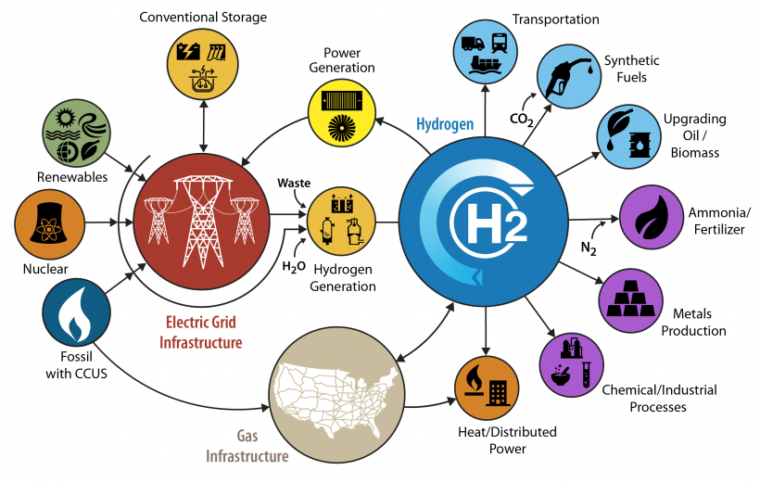
Hydrogen for heavy-duty vehicles
Larger tanks ➔ lower pressure H₂ ➔
less energy to compress the H₂
AND long driving ranges
Credit: DOE
DOE has a Million Mile Fuel Cell Truck initiative working on PEM technology to maximize onboard hydrogen use
DOE also has an H₂@Scale vision

Slide 32
Hydrogen and the net-zero energy economy
What is hydrogen?
How is hydrogen manufactured?
What is hydrogen used for?
How can hydrogen be integrated into
the net-zero energy economy?
(production, storage, transport)
Policies to promote blue and green hydrogen

Slide 33
Hydrogen
Supply
Chains
Issues: pipelines, shipping/trucking,
conversion and reconversion, storage (tanks, geological)

Slide 34
Hydrogen safety
Hindenburg explosion, 1937
Lakehurst, NJ
62 of 97 passengers & crew survived

Slide 35
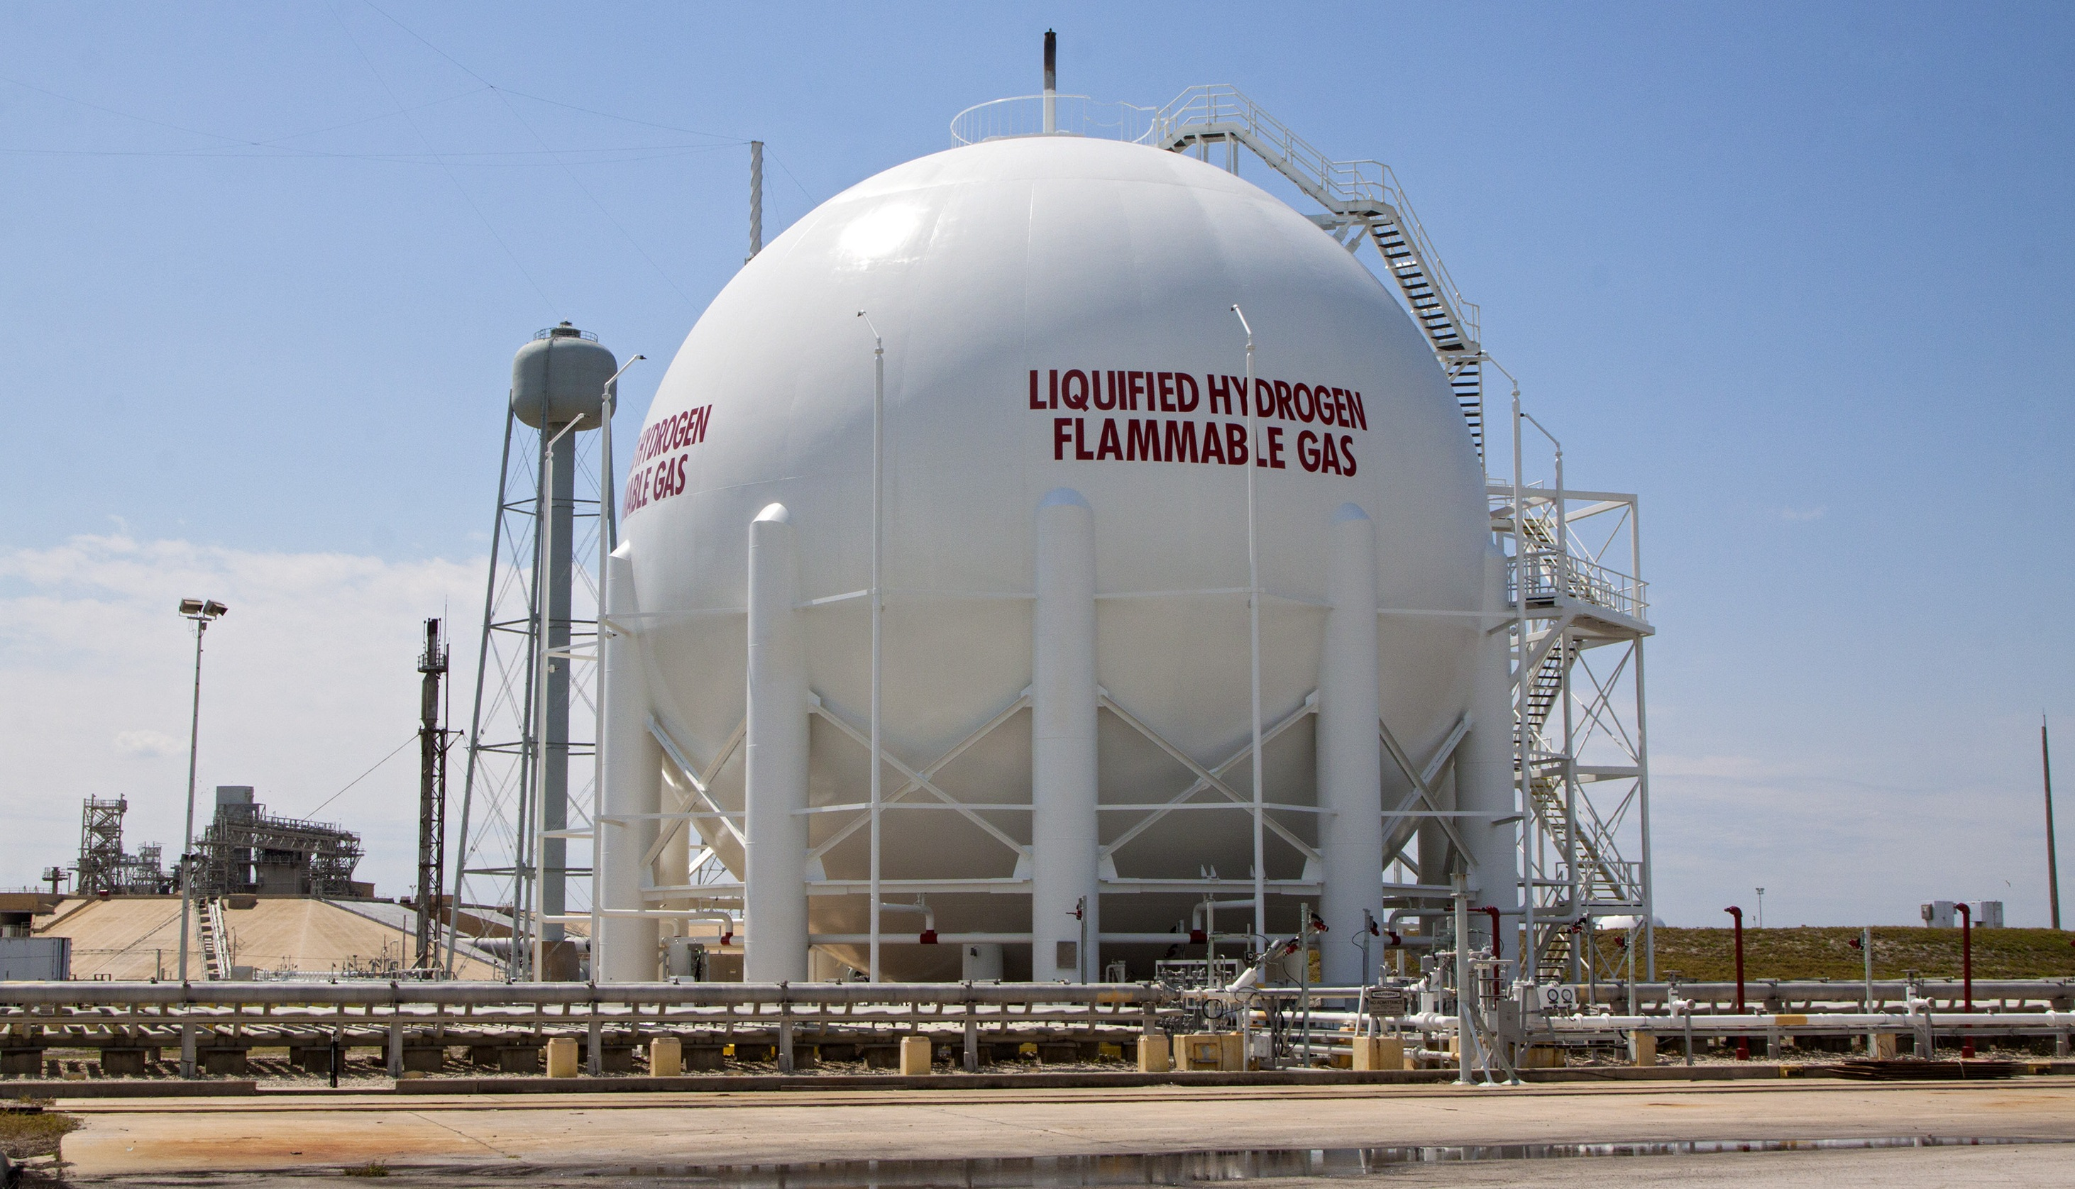
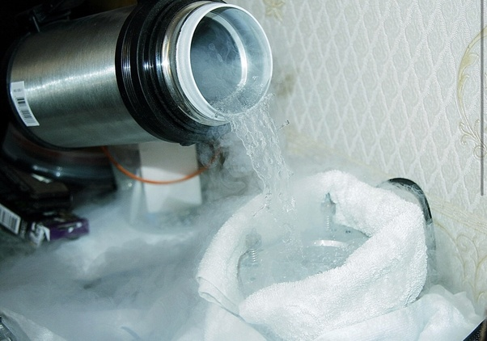
Major hydrogen challenge
Dry Ice (solid CO₂)
Sublimes at -78.5C
Liquid hydrogen
Boiling Pt. = -253C
Liquid nitrogen
Boiling Pt. = -196C
Credit: sciencenotes.org

Slide 36
Potential storage and transport pathways for hydrogen
MCH = methylcyclohexane
Credit: International Renewable Energy Agency (IRENA)

Slide 37
Hydrogen conversion to other carrier molecules/fuels
Credit: IEA
Conversion means loss of 45-60% of the input electrical energy
used to make the hydrogen by electrolysis
Liquid ammonia ➔ boiling pt = -33C, well-established technology

Slide 38
Can natural gas pipelines carry hydrogen? How much?
Credit: IEA
Widely varying tolerance of natural gas infrastructure for hydrogen blends
Embrittlement of steel pipelines is one of the issues

Slide 39
Credit: Sandia National Labs

Slide 40
HyBlend project
NREL together with five other national labs, 20+ industry/academic labs
Will test hydrogen compatibility of metal and polymer pipelines
Lifecycle emissions calculations of natural gas/hydrogen blends
Costs and economic opportunities
Leverages work of Hydrogen Materials Compatibility Consortium (H-Mat) [DOE]
Also: SoCal Gas and SDG&E Hydrogen Blending Demonstration Program
https://www.sempra.com/socalgas-and-sdge-announce-groundbreaking-
hydrogen-blending-demonstration-program-help-reduce

Slide 41
California Fuel Cell Partnership
Funded by AB 8, 2012
Public-private partnership to promote
hydrogen fueling infrastructure
Cumulative sales of fuel cell
cars now over 10,000 (2021)
Includes road map for fuel cell
electric buses:
Ahead of its time??
Green = open, retail

Slide 42
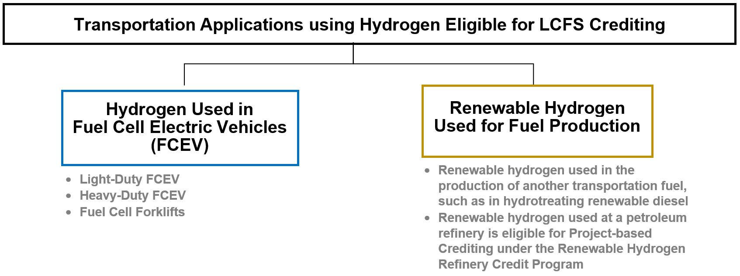
Policy: Hydrogen and the Low Carbon Fuel Standard (LCFS)
Credit: California Air Resources Board
Electricity used for hydrogen production is also eligible for credits

Slide 43
Policies to Promote Hydrogen
Credit: IEA
National H₂ roadmap and vision; quantitative emissions reduction law
Present state in US: nonexistent
Create demand: put economic value on hydrogen
Presently in US: CA, OR LCFS, state ZEV mandates, state carbon price
Mitigate investment risks (tax credit, green bank financing, PPPs)
Presently in US: 45Q CCS tax credit
R&D, pilot projects
Presently in US: DOE funding; utility gas mixture pilot programs
Harmonize standards/remove barriers

Slide 44
Thank you!
www.fromknowledgetopower.com
https://www.linkedin.com/in/john-perona-b31542124/
perona@pdx.edu

